Slide 1

Mycenae
The capital of Agamemnon
Notes:
This presentation begins with general views, continues with a tour of the fortifications, summit, palace, secret cistern entrance, and concludes at the Lion Tomb.
The Pictorial Library of Bible Lands provides PowerPoint files in addition to individual jpg images. The PowerPoint files are organized in logical sequence and may provide a quicker option for copying slides into other presentations. The PowerPoint files also include annotations about the sites and images that are not available elsewhere.
The images in the PowerPoints are approximately 1024x768 pixels. Users will particularly benefit from accessing the individual higher-resolution jpg images if (1) they have a projection system higher than 1024x768; (2) they want to zoom in on a particular portion of an image; or (3) they want to crop, edit, adapt, or print an image.

Slide 2
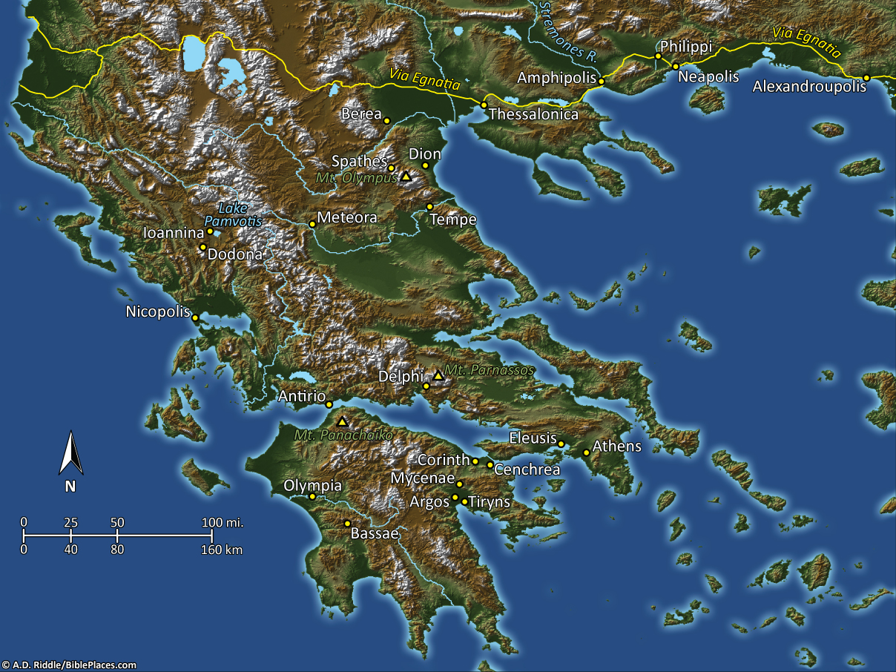
Pictorial Library Vol. 11: Greece
Notes:
This map is intended to help users locate the places which appear in the photographs in this presentation. The map therefore does not represent or label every geographic feature, and the sites are a mixture of modern and ancient place names.

Slide 3
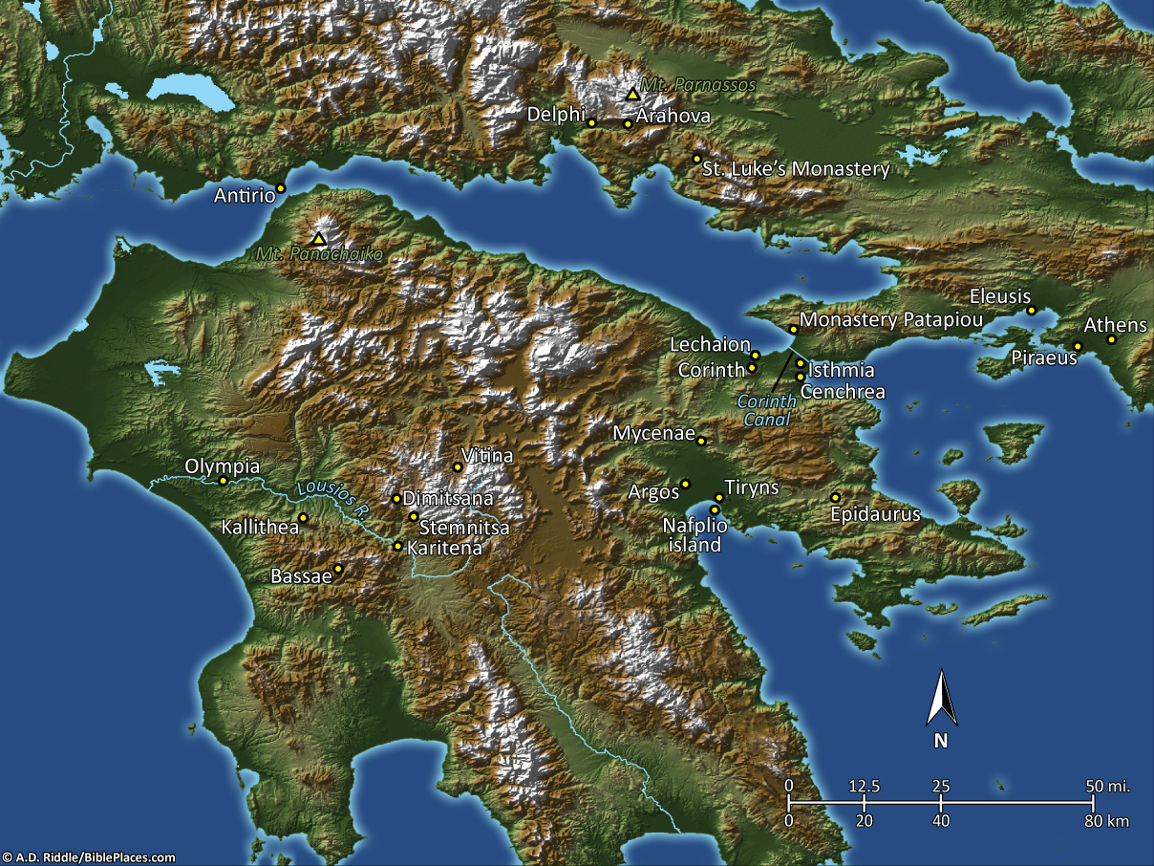
Pictorial Library Vol. 11: Peloponnese
Notes:
This map is intended to help users locate the places which appear in the photographs in this presentation. The map therefore does not represent or label every geographic feature, and the sites are a mixture of modern and ancient place names.

Slide 4
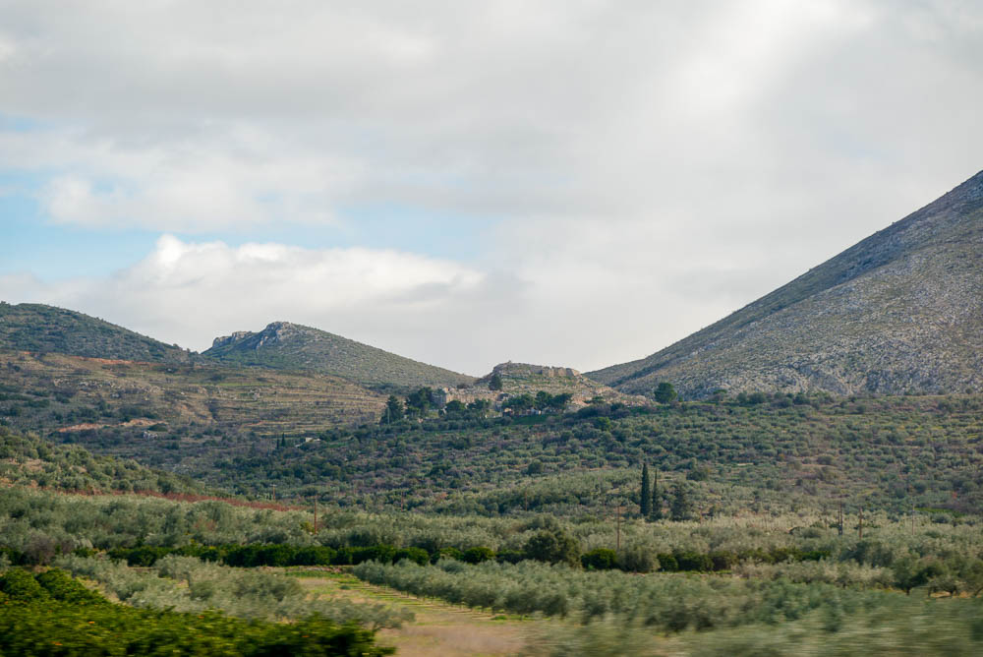
Mycenae from west
Notes:
Historical Background
The remains at Mycenae date back to Neolithic times. Although very little remains on the site today, save the citadel wall and various graves, several shaft graves from the Late Helladic I period (ca. 1550 BC) show growth in the city during that time.
According to Greek mythology, Perseus was the founder of the city and the Mycenaean kingdom. It was during this time that the city of Mycenae saw its days of glory (ca. 1650-1100 BC; Middle Helladic and following).
Mycenae controlled roads leading north to Corinth and the Isthmus. It became the center of Helladic culture, described by Homer as “rich in gold,” “well-built,” and “broad-streeted.” The city declined in greatness after the Dorian tribes defeated the Mycenaean kingdom, and Mycenae was destroyed by fire in the 12th century BC. It was abandoned for several centuries, and then a new township on the site was destroyed by Argos in 468 BC. Only a small Hellenistic town occupied Mycenae after that point, and the site was finally abandoned in the 3rd century AD.
tb011123608

Slide 5
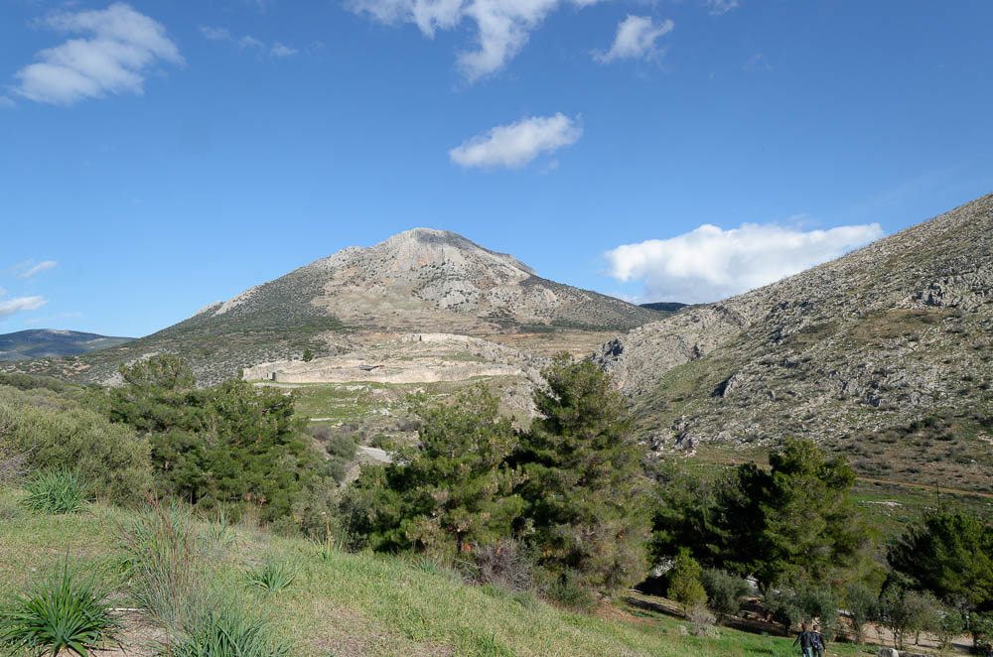
Mycenae citadel from south
Notes:
bjb011123025

Slide 6
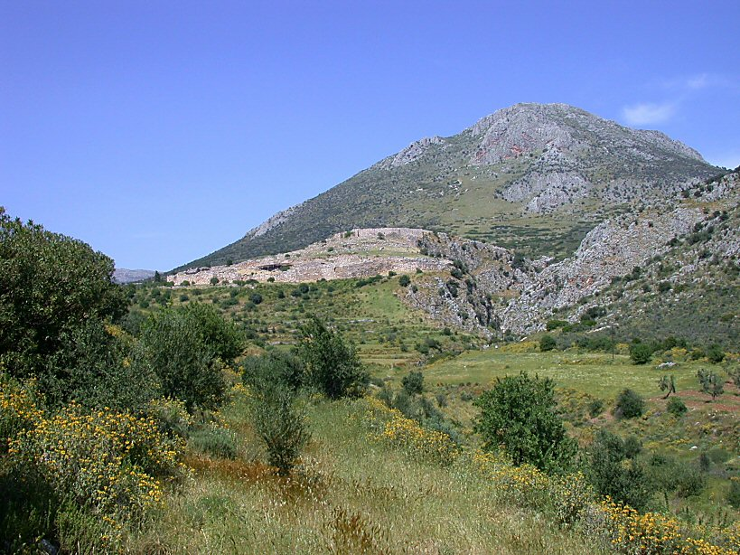
Mycenae citadel from southwest
Notes:
df051003502

Slide 7
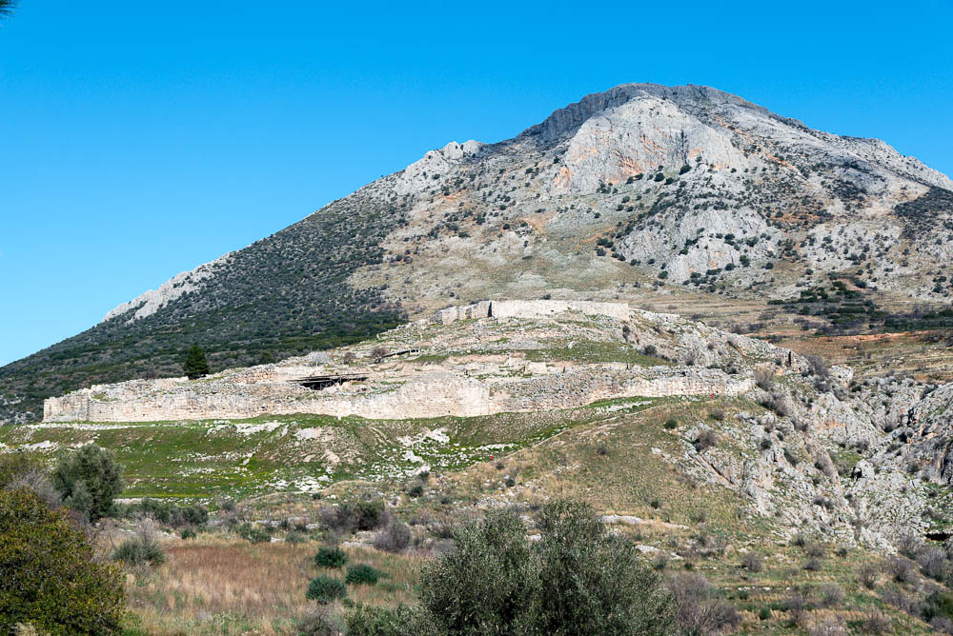
Mycenae citadel from south
Notes:
tb011123647

Slide 8
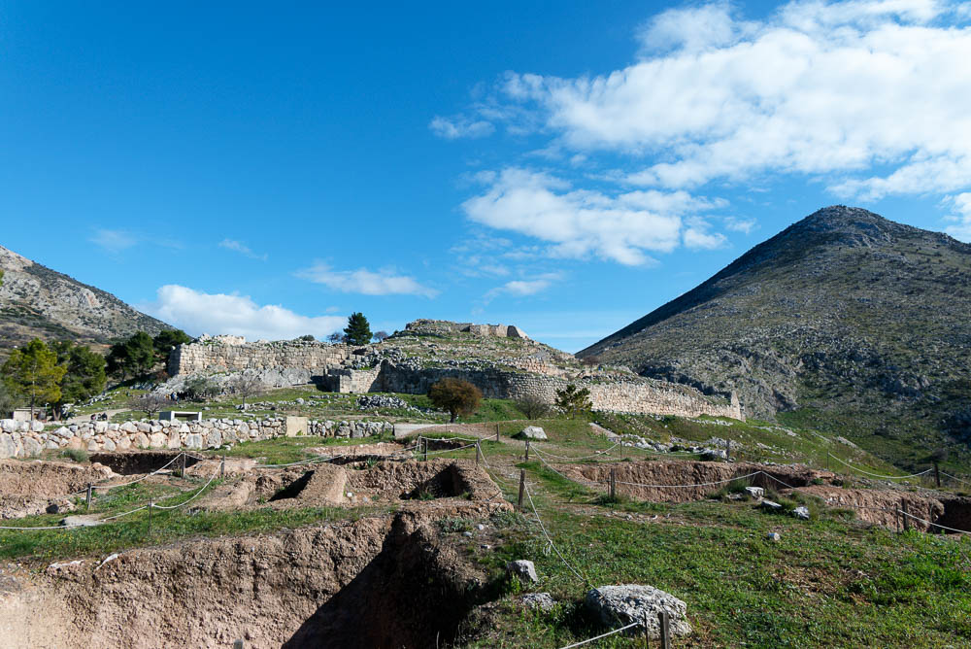
Mycenae citadel from west
Notes:
Excavations
Heinrich Schliemann began excavations on the tholos (beehive-shaped) tombs of Mycenae in 1874–1876 and was succeeded by Panagiotis Stamatakis. Christos Tsountas led the Greek Archaeological Society in digs from 1886–1902, and the British School at Athens excavated under Alan Wace in 1920–1923, 1939, and 1950–55. The Greek government has been involved in restorations at the site, while the Greek Archaeological Society keeps a watchful eye on all modern excavations (done by the British) at Mycenae. One of the most popular finds on the site was the so-called mask of Agamemnon (which Schliemann found but wrongly identified), now on display in the Athens Archaeological Museum.
tb011123651

Slide 9
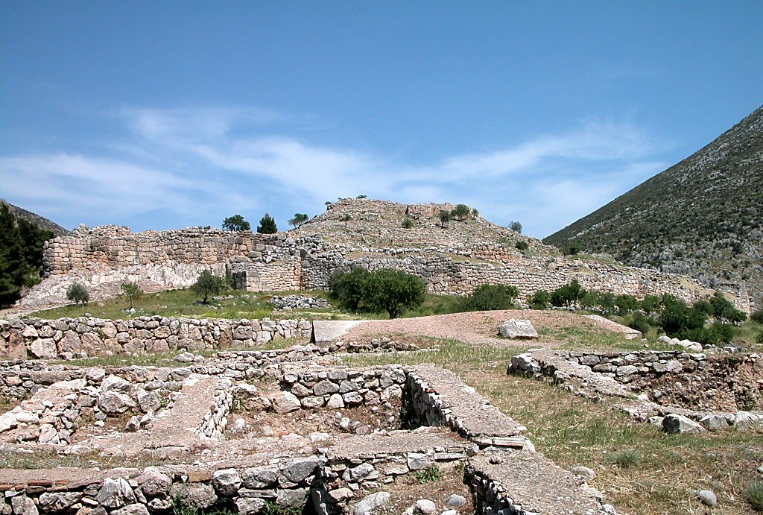
22
Mycenae citadel from west
Notes:
tb050903186

Slide 10
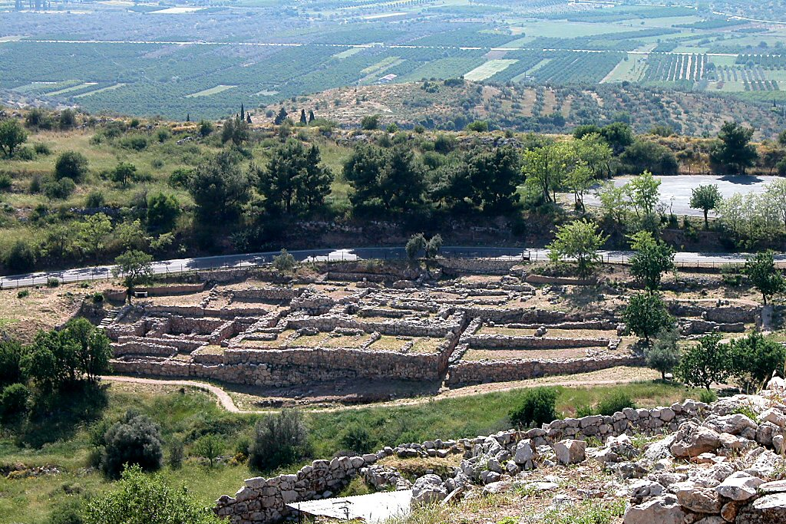
Mycenae houses west of citadel
Notes:
The only approach to Mycenae's citadel was from the west, due to its placement by steep valleys. The houses shown here sat near the route leading up to the fortress.
tb050903200

Slide 11
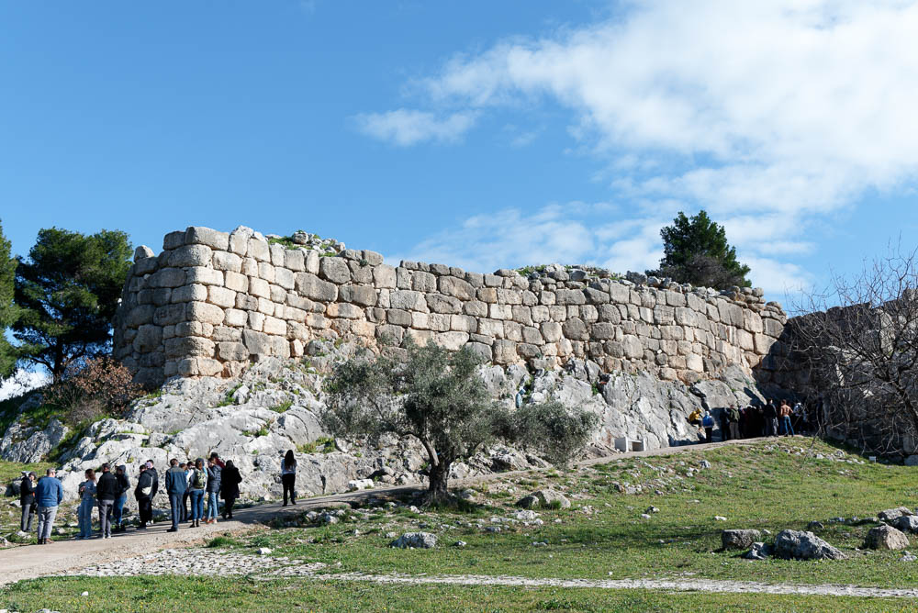
Mycenae fortification wall near Lion Gate
Notes:
The walls at Mycenae were built from the 15th to the 13th century BC. Early Greeks called them “Cyclopean” walls, because their enormous stones were thought to have been manageable only by Cyclopes.
tb011123654

Slide 12
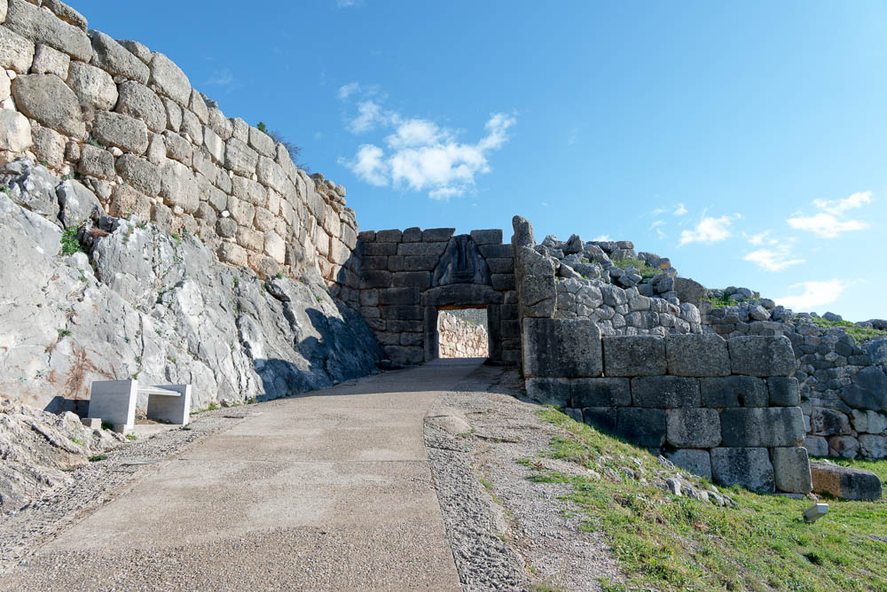
Mycenae approach to Lion Gate
Notes:
tb011123728

Slide 13
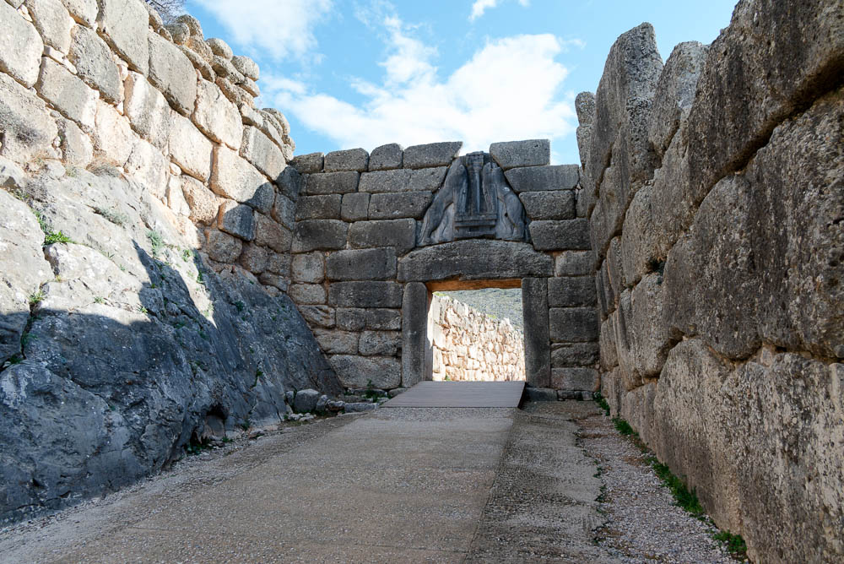
Mycenae Lion Gate
Notes:
Two lions or lionesses are carved above the lintel of this 13th century BC gate. Although their heads, made of a different type of stone, are no longer present, their bodies can still be seen holding up a pillar between them. A tower once sat just right of this very early monumental sculpture.
tb011123669

Slide 14
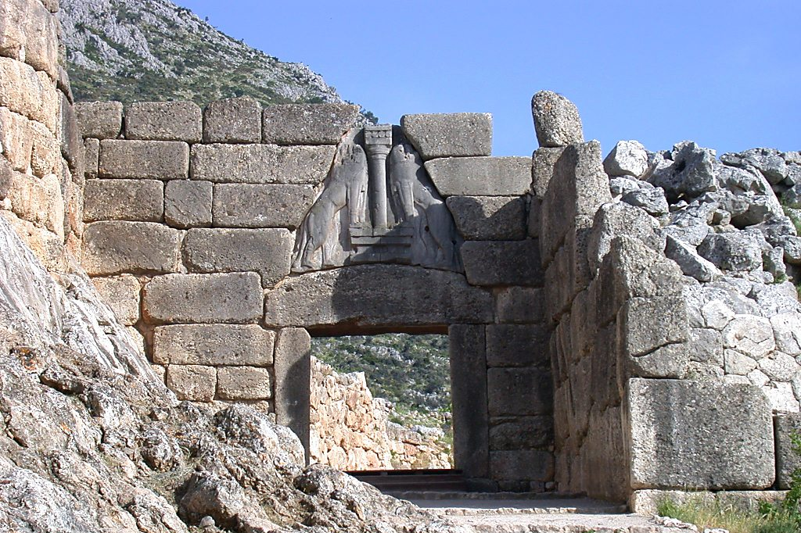
Mycenae Lion Gate
Notes:
df051003501

Slide 15
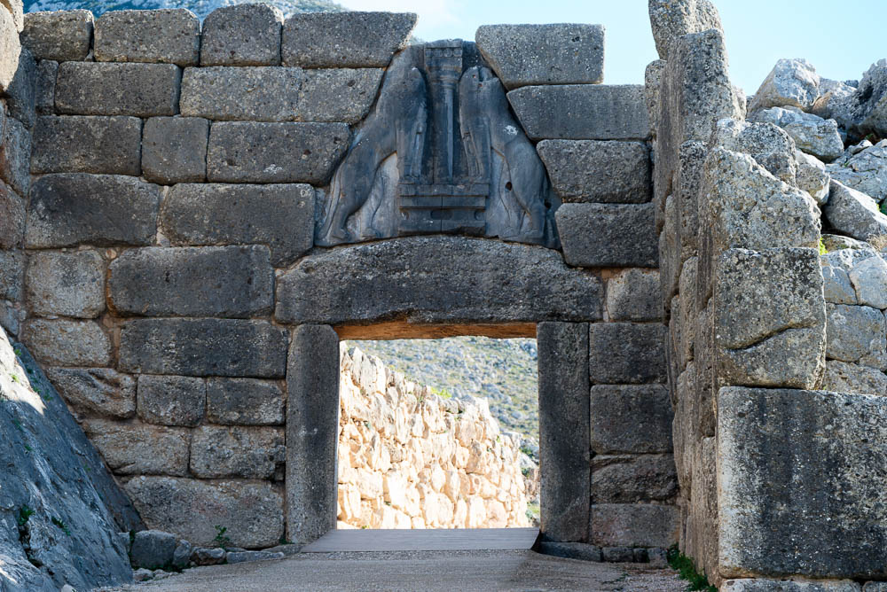
Mycenae Lion Gate
Notes:
The imposing stone architecture of this gate, with its two lions sculpted in high relief, symbolizes power and protection.
tb011123659

Slide 16
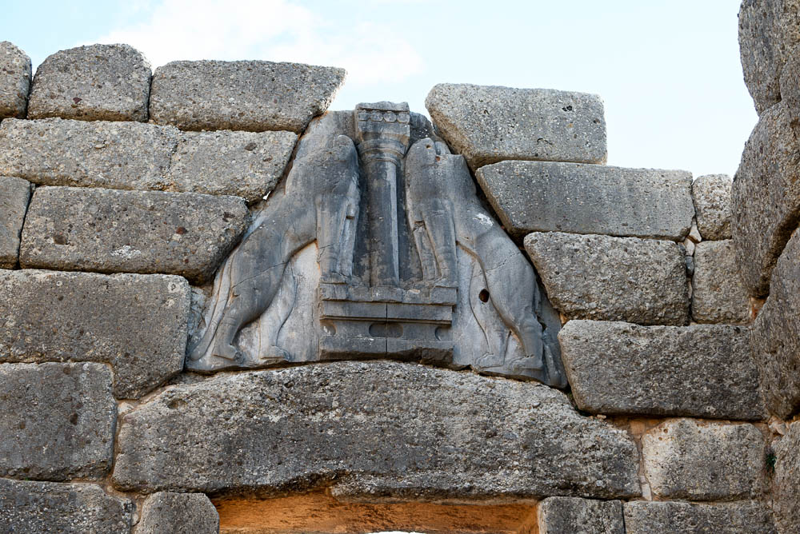
Mycenae Lion Gate relief
Notes:
tb011123664

Slide 17
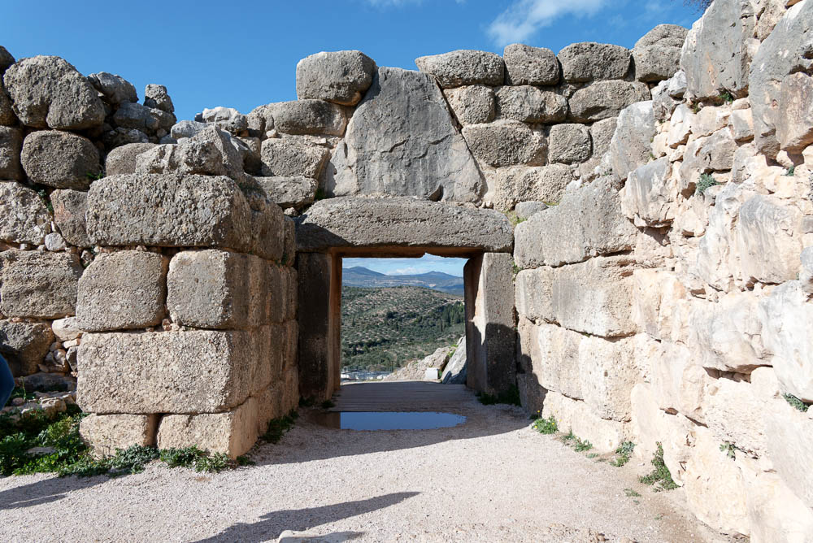
Mycenae Lion Gate from inside citadel
Notes:
tb011123666

Slide 18
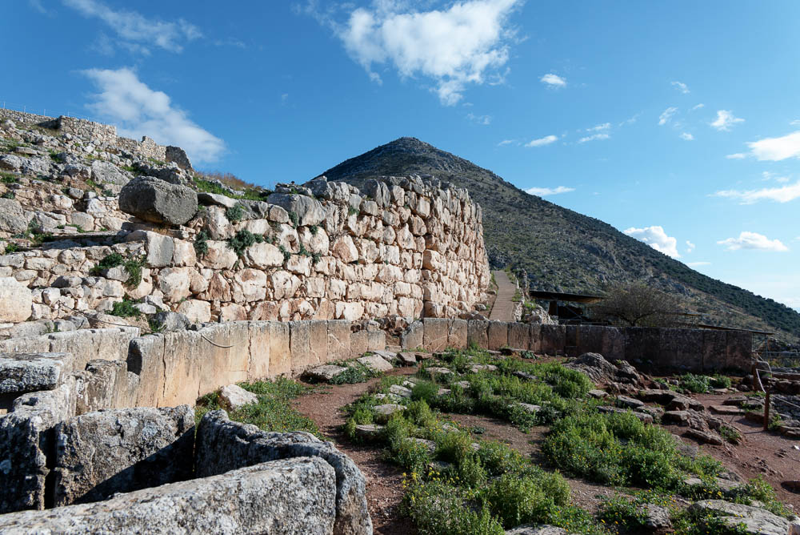
Mycenae fortification wall near Grave Circle A
Notes:
tb011123720

Slide 19
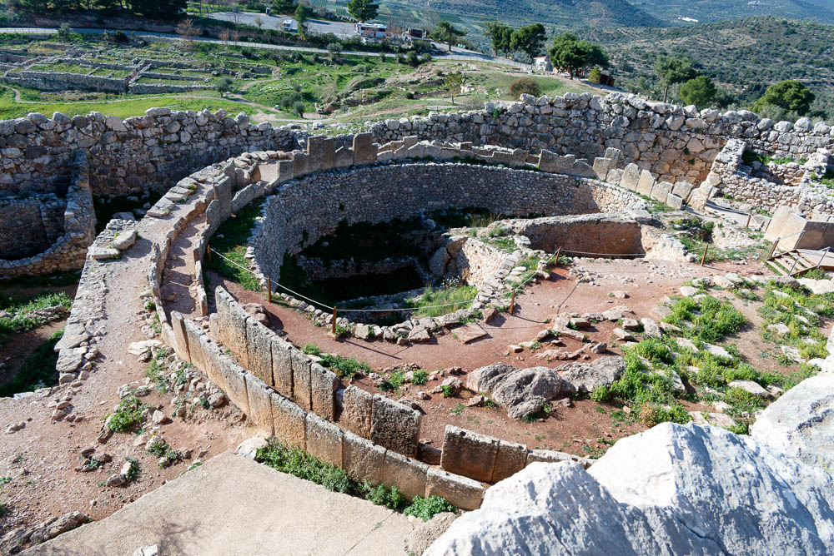
Mycenae Grave Circle A
Notes:
Grave Circles A and B date to the early period of Mycenae (circa 1600 BC) and include a total of 20 shaft graves. Nine of these are tholos (beehive-shaped) tombs. The wealth of the inhabitants is shown by the tremendous amount of luxury items discovered in these tombs, including gold masks, cups, swords, and jewelry. The finds reveal the extensive commercial network that Mycenae participated in at the time.
tb011123715

Slide 20
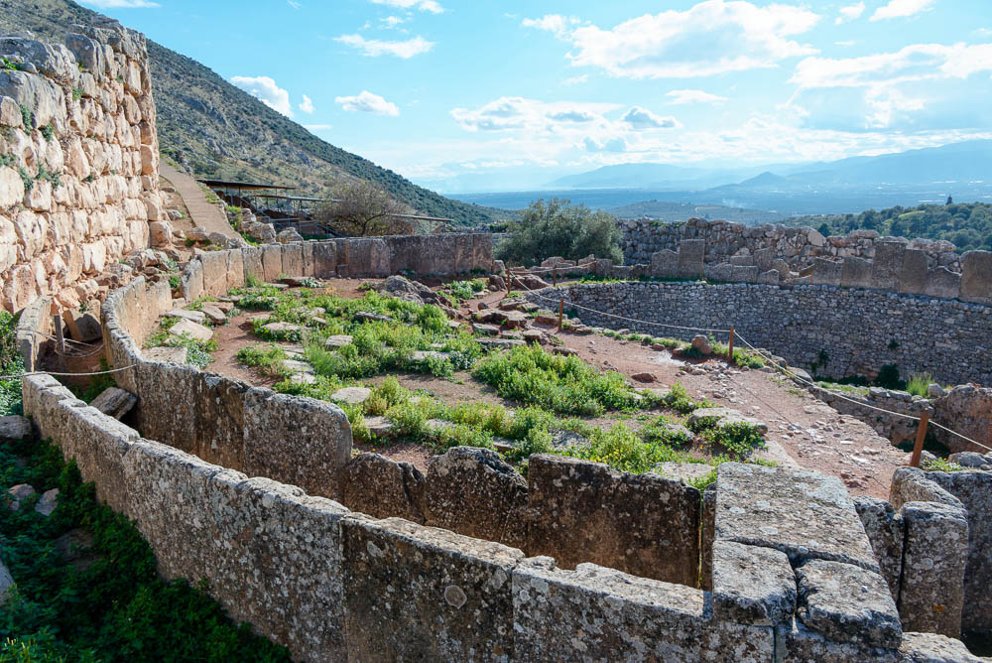
Mycenae Grave Circle A
Notes:
tb011123716

Slide 21
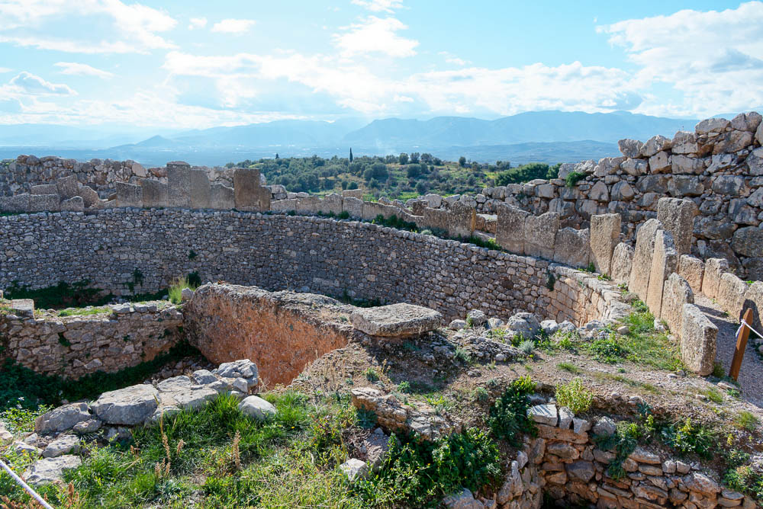
Mycenae Grave Circle A
Notes:
tb011123717

Slide 22
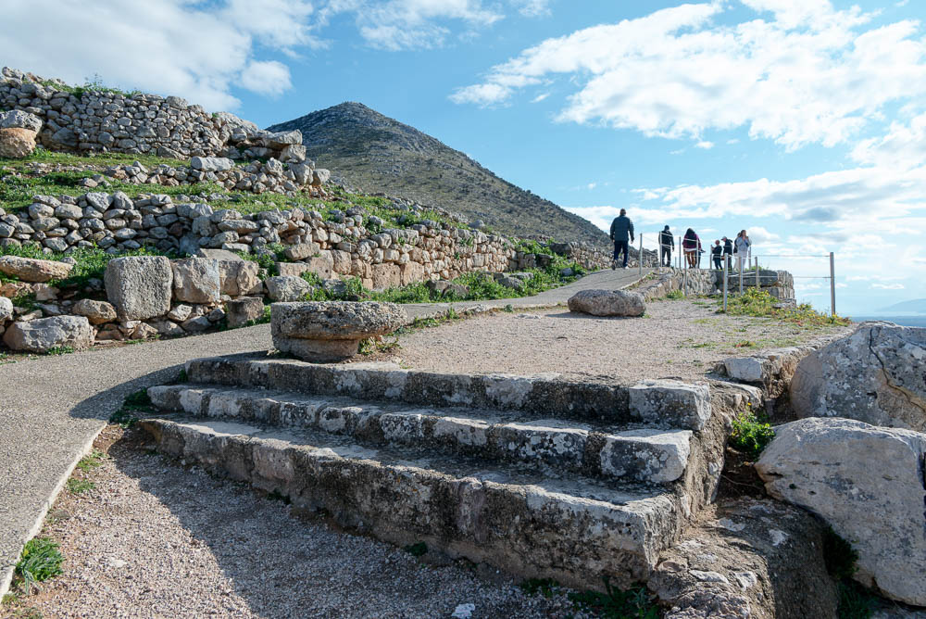
Mycenae palace propylon
Notes:
tb011123687

Slide 23
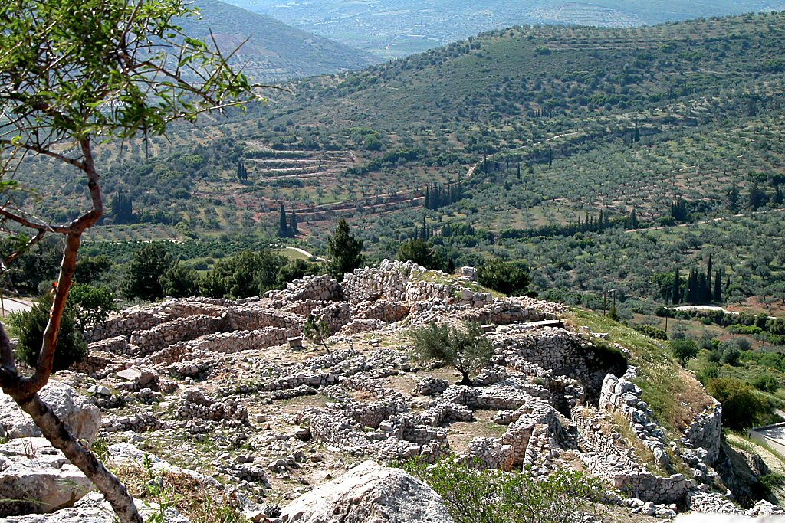
Mycenae palace from east
Notes:
The Mycenae palace sat at the top of the citadel. Although little remains today, it was large and ostentatious at one time.
tb050903202

Slide 24
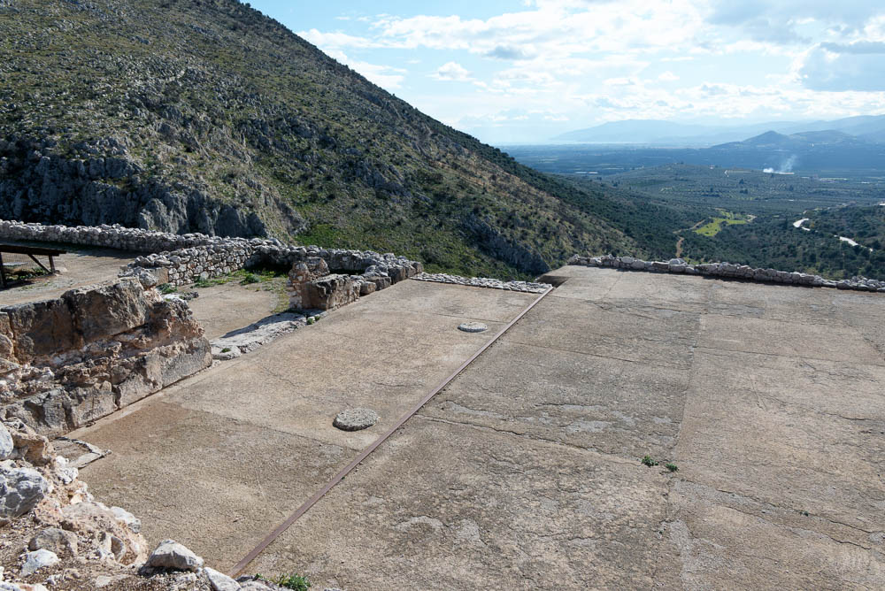
Mycenae palace megaron
Notes:
The megaron had a porch, vestibule, throne room, and two wooden columns. Battle scenes were painted all around the room and the sacred hearth was situated in the middle.
tb011123689

Slide 25
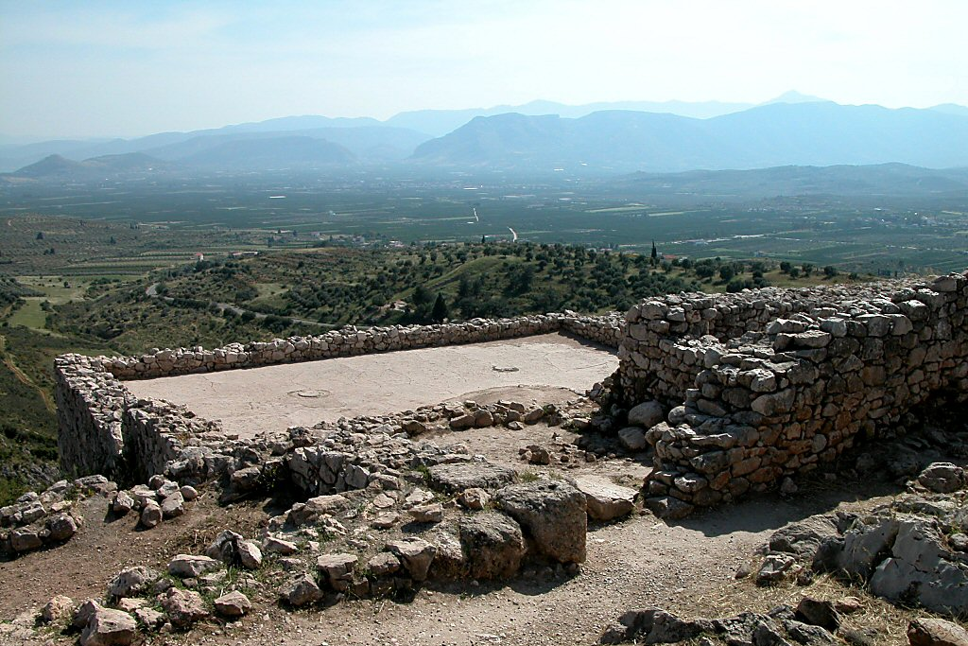
Mycenae palace megaron from north
Notes:
tb050903196

Slide 26
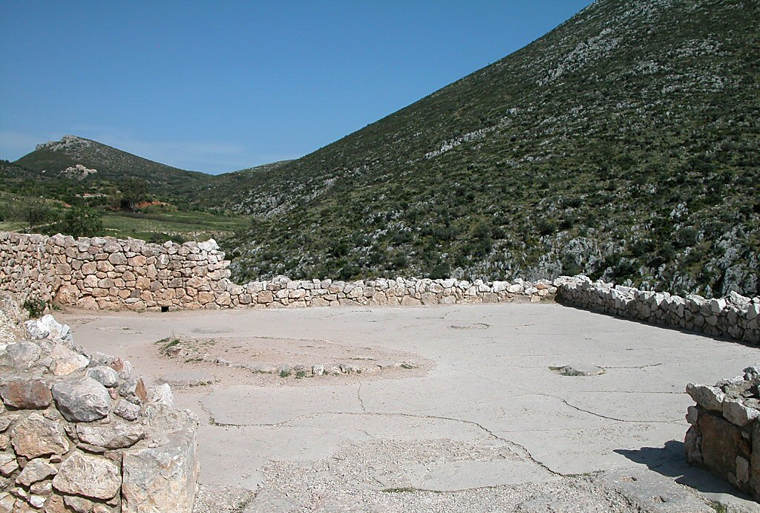
Mycenae palace megaron from west
Notes:
tb050903199

Slide 27
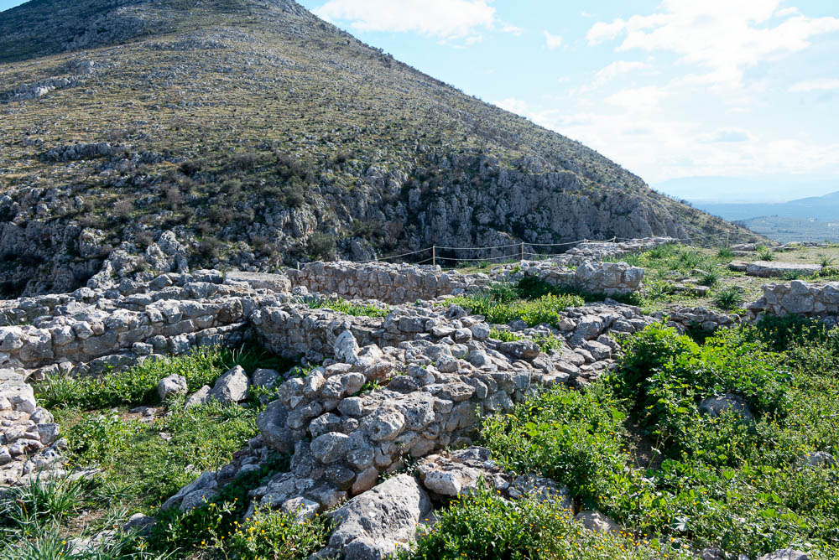
Mycenae House of Columns
Notes:
This structure has been identified as part of the palace complex. It is situated on a terrace to the east of the main building of the palace.
tb011123707

Slide 28
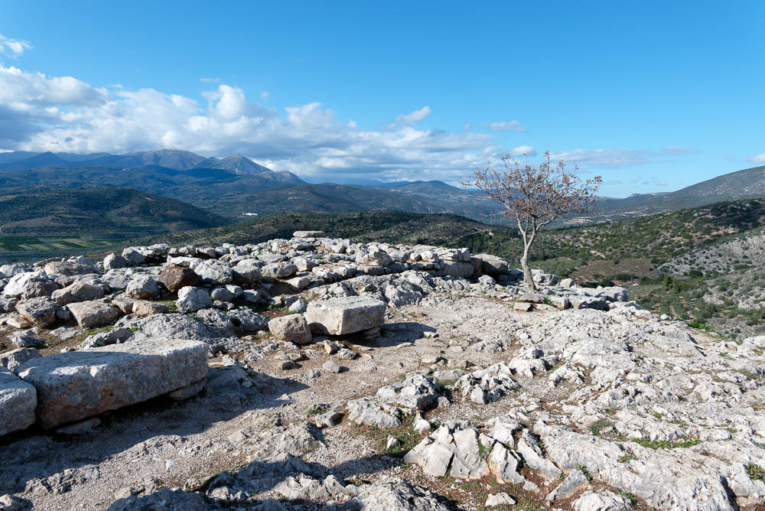
Mycenae temples area
Notes:
A temple was built on the citadel at a later period, around the end of the 7th century. In the 3rd century, a Hellenistic temple was built on this temple's foundation. Reliefs and a female statue head were uncovered from the remains of the earlier temple.
tb011123692

Slide 29
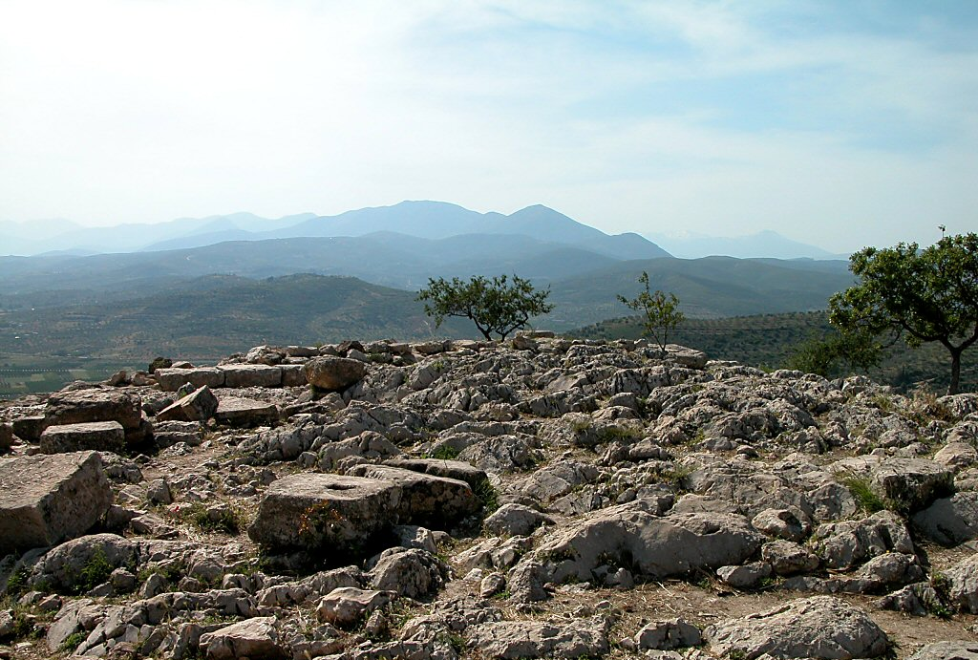
Mycenae temples area
Notes:
tb050903203

Slide 30
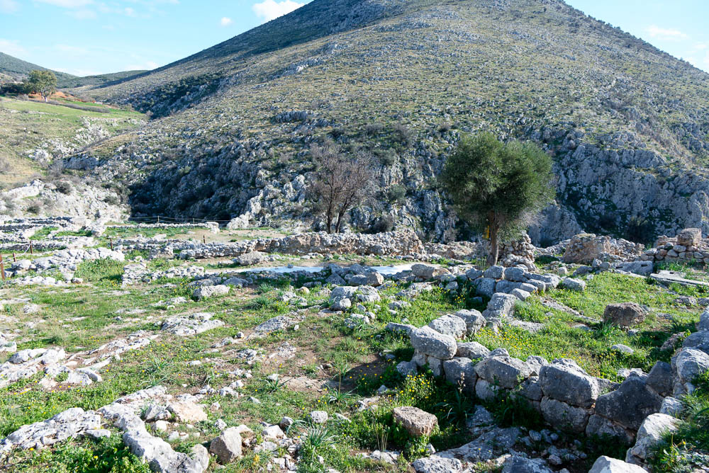
Mycenae excavations near citadel summit
Notes:
tb011123697

Slide 31
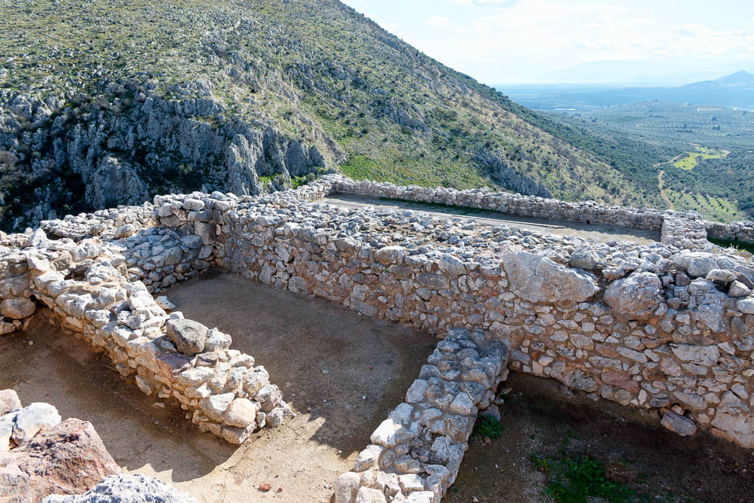
Mycenae building near citadel summit
Notes:
tb011123693

Slide 32
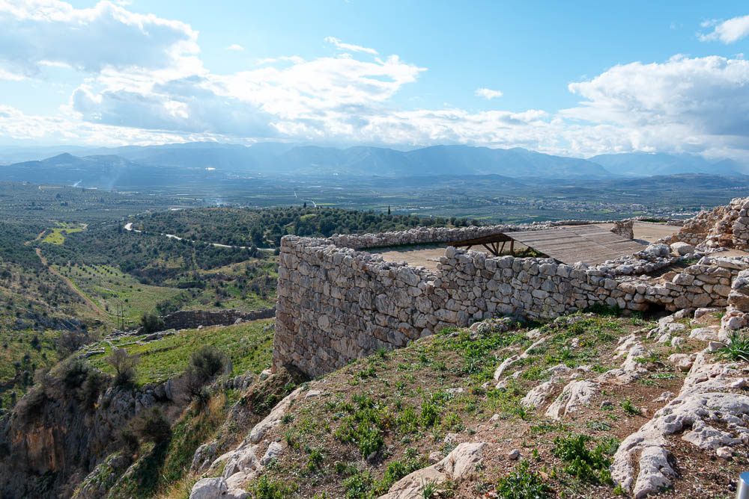
Mycenae view west from citadel
Notes:
tb011123694

Slide 33
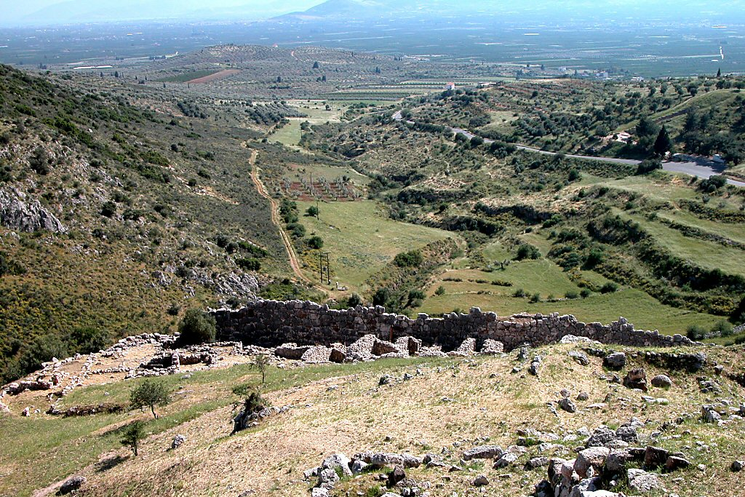
Mycenae southern wall and valley
Notes:
tb050903201

Slide 34
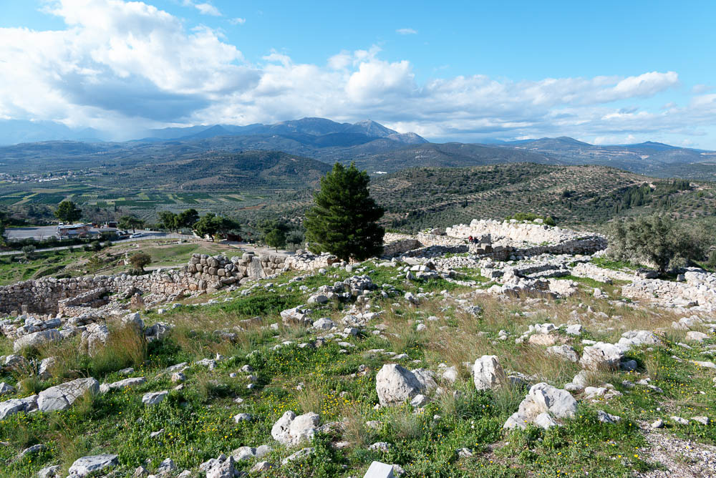
Mycenae north quarter and buildings on north slope
Notes:
A large four-room building and two other building complexes have been excavated on the north slope of the citadel. This area seems to have been in peak use during the second half of the 13th century BC and eventually destroyed in an earthquake.
tb011123681

Slide 35
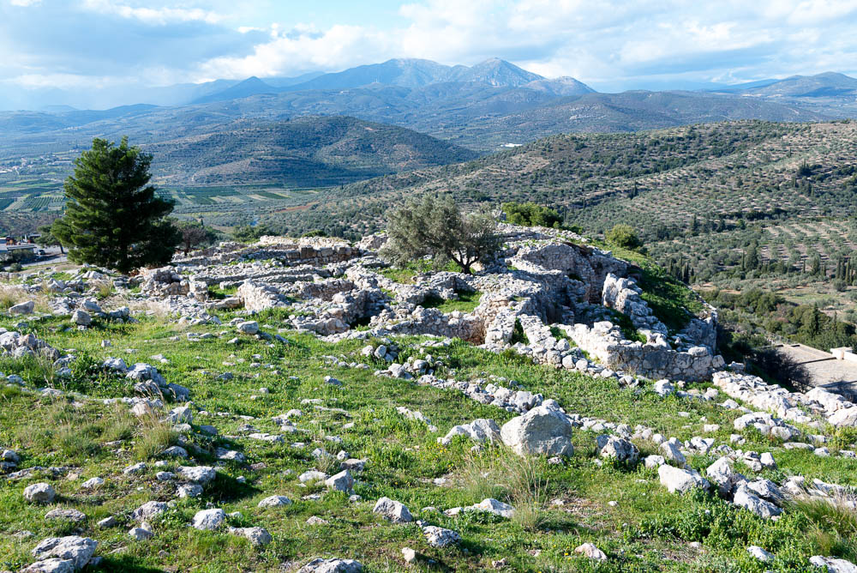
Mycenae north quarter and buildings on north slope
Notes:
tb011123713

Slide 36
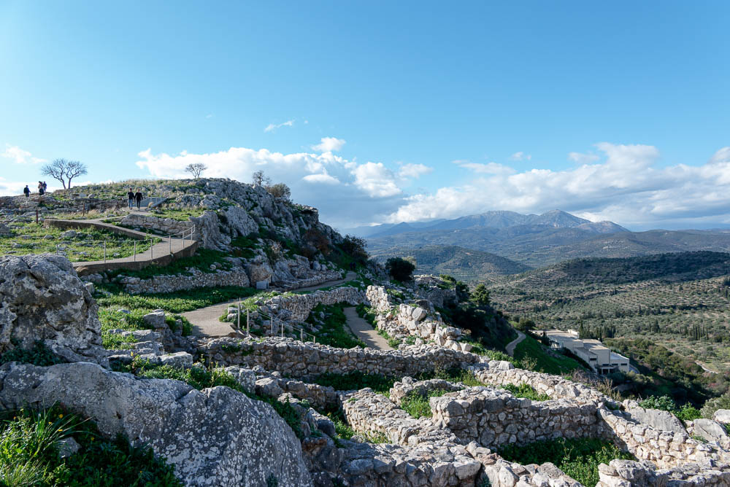
Mycenae Building Gamma and North Storerooms
Notes:
tb011123702

Slide 37
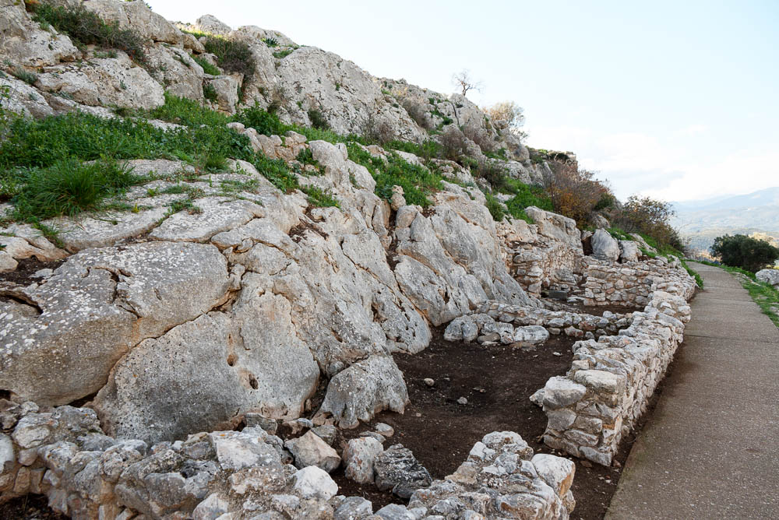
Mycenae North Storerooms
Notes:
One of the north slope structures is a series of four storerooms. They sit adjacent to the citadel’s fortification wall.
tb011123709

Slide 38
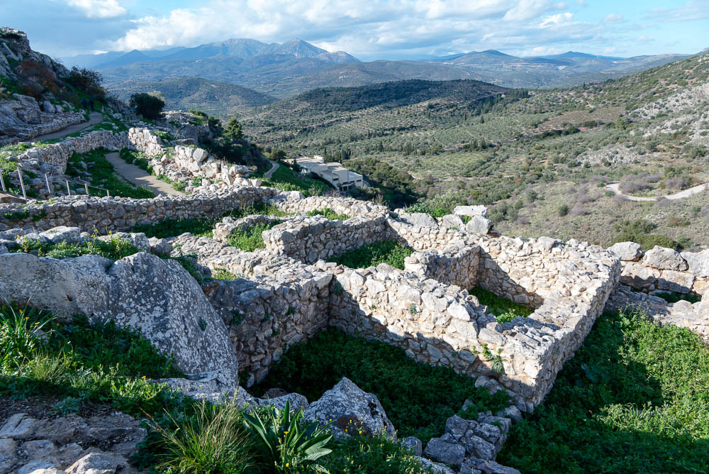
Mycenae Building Gamma
Notes:
Building Gamma was in use in the middle of the 13th century and destroyed by fire. Only the basement remains.
tb011123701

Slide 39
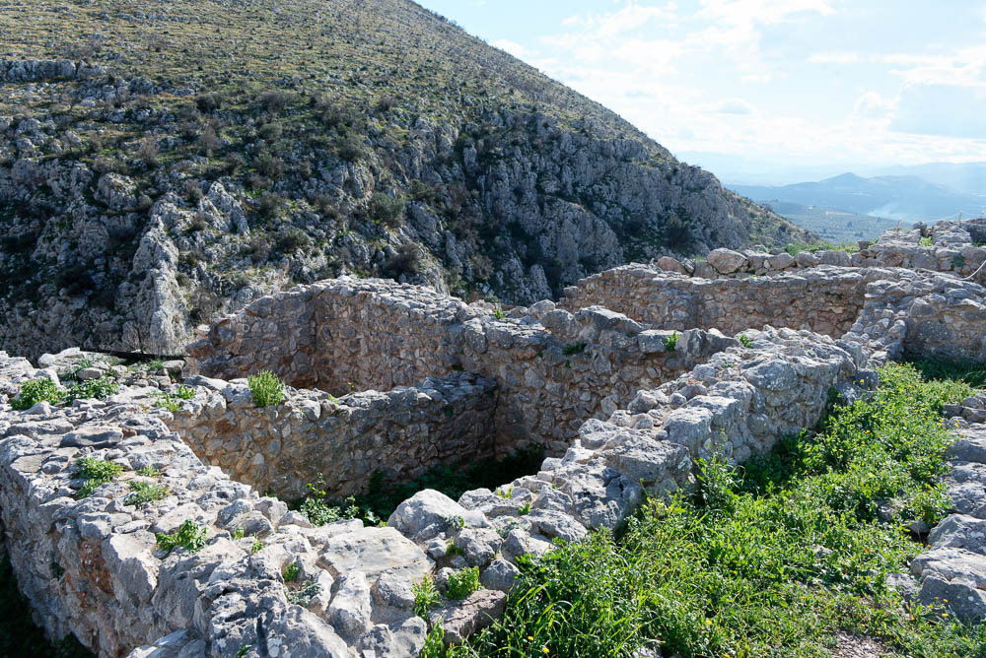
Mycenae Building Delta
Notes:
On the east side of the citadel, north of the House of Columns, is Building Delta. The basement level and parts of a staircase have been preserved.
tb011123704

Slide 40
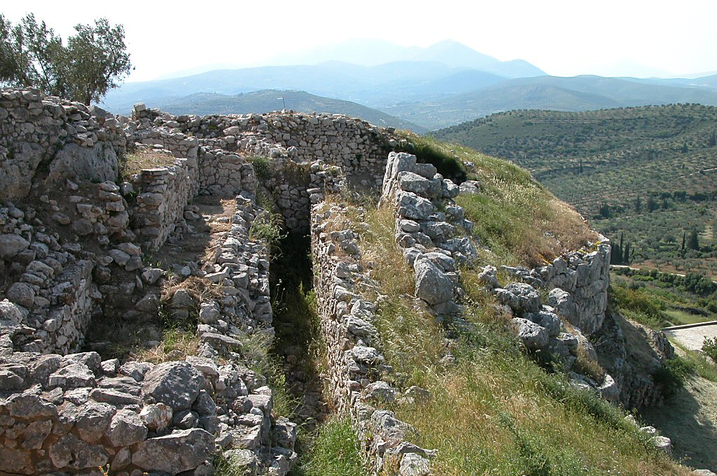
Mycenae northern fortifications
Notes:
tb050903204

Slide 41
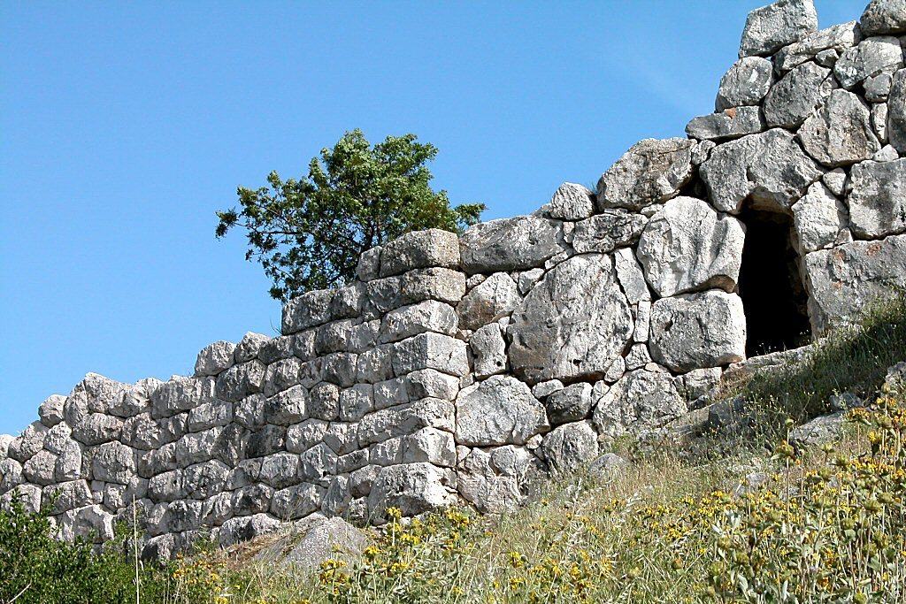
Mycenae northern wall with drain
Notes:
tb050903213

Slide 42
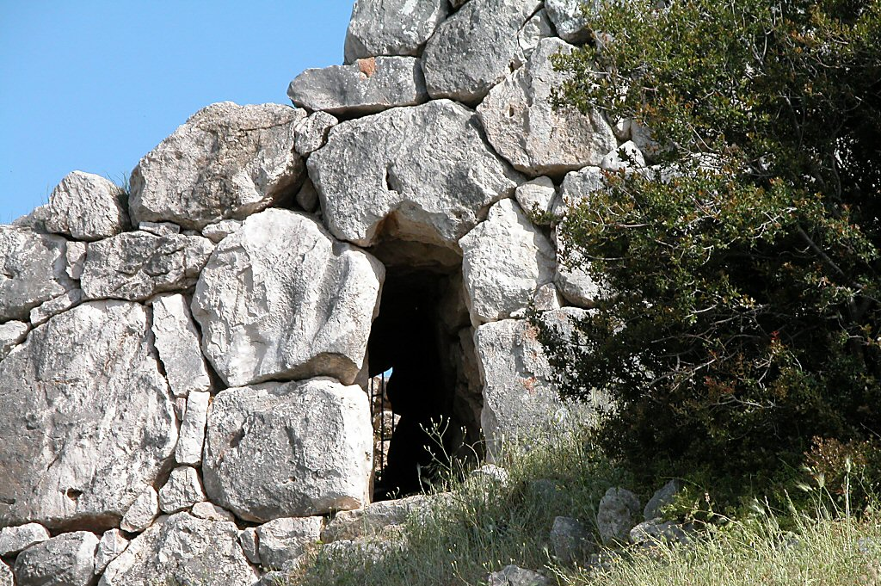
Mycenae drain through wall
Notes:
tb050903212

Slide 43
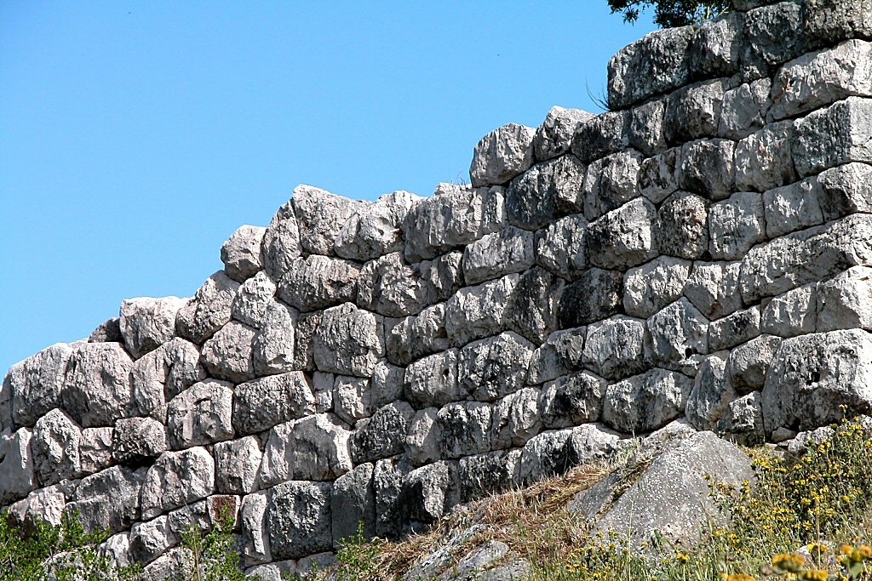
Mycenae northern wall with polygonal stones
Notes:
Ashlar masonry was used in the original construction of the citadel wall; however, repairs made in the Hellenistic period were done with polygonal stones, as pictured above.
tb050903211

Slide 44
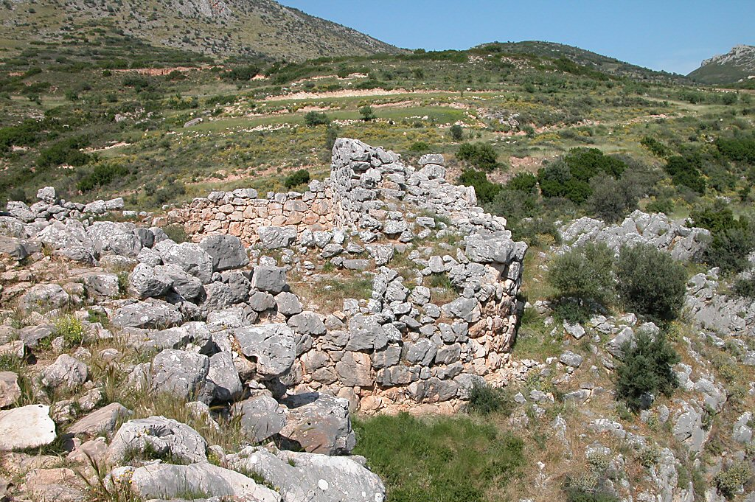
Mycenae round tower on east
Notes:
On the east side of the citadel, the fortifications were extended in the late 13th century to surround a cistern.
tb050903195

Slide 45
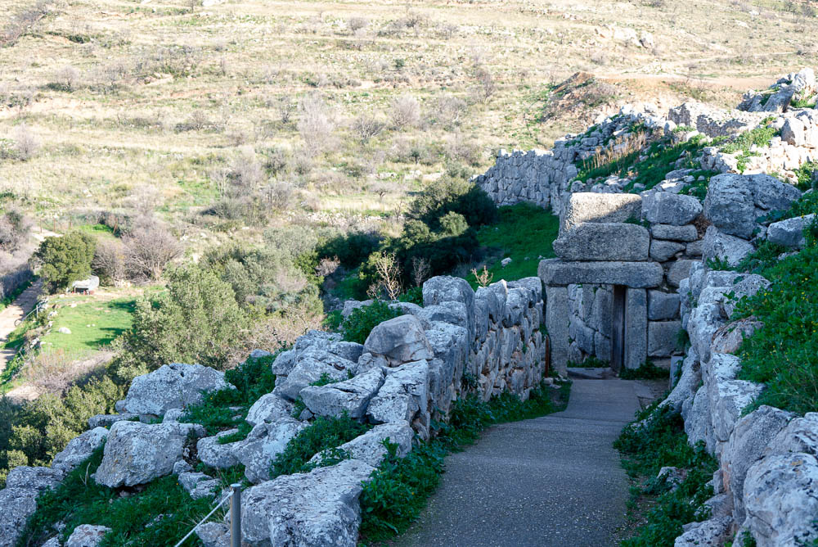
Mycenae postern gate
Notes:
This postern gate dates to the same time as the Lion Gate (13th century BC). It served a dual purpose, both protecting the water supply and providing an escape route when necessary.
tb011123712

Slide 46
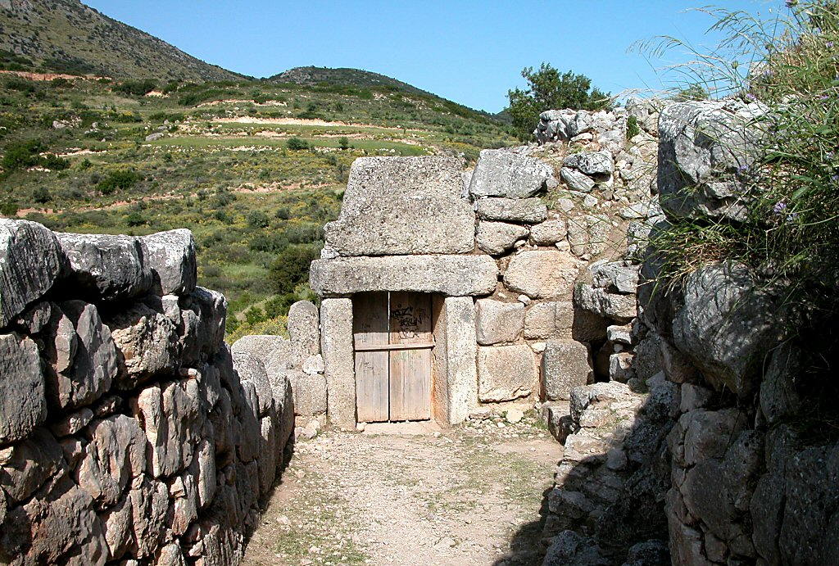
Mycenae postern gate
Notes:
tb050903210

Slide 47
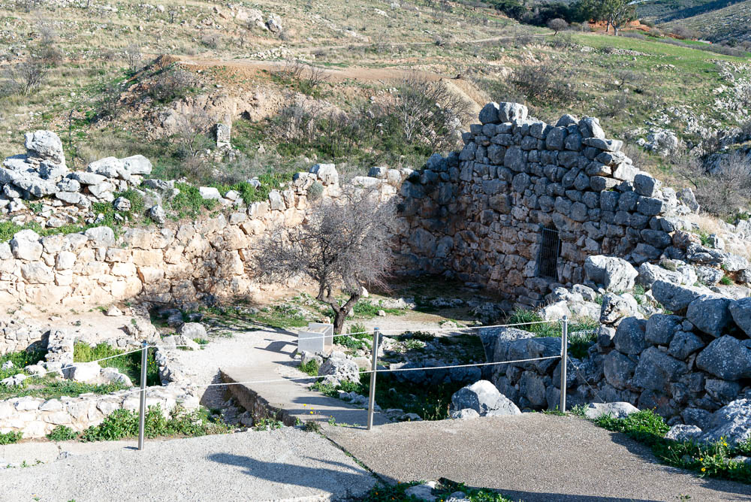
Mycenae sally port
Notes:
During a siege, this sally port on the eastern end of the citadel provided a means for scouts to go in and out of the city wall.
tb011123705

Slide 48
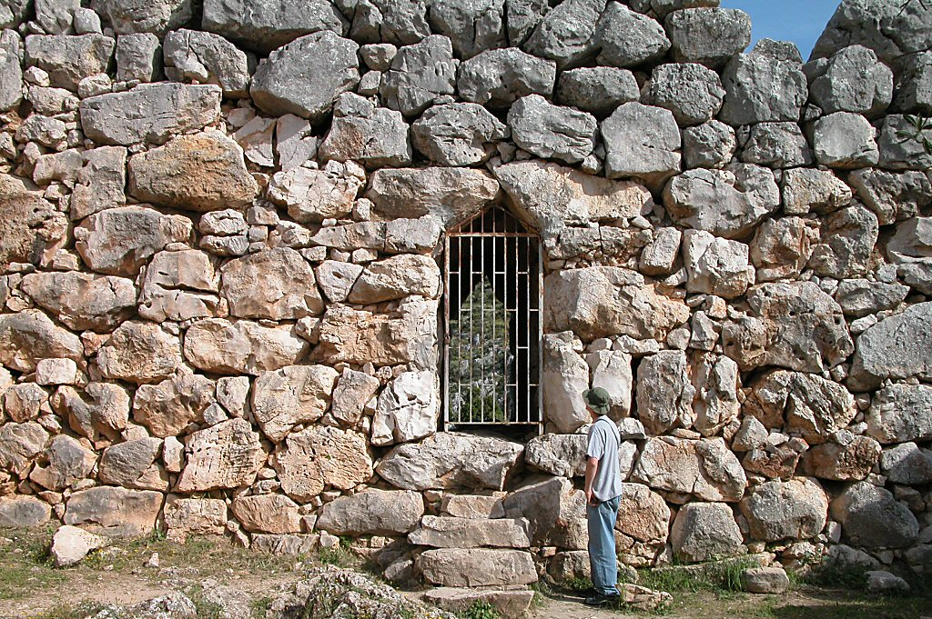
Mycenae sally port
Notes:
tb050903215

Slide 49
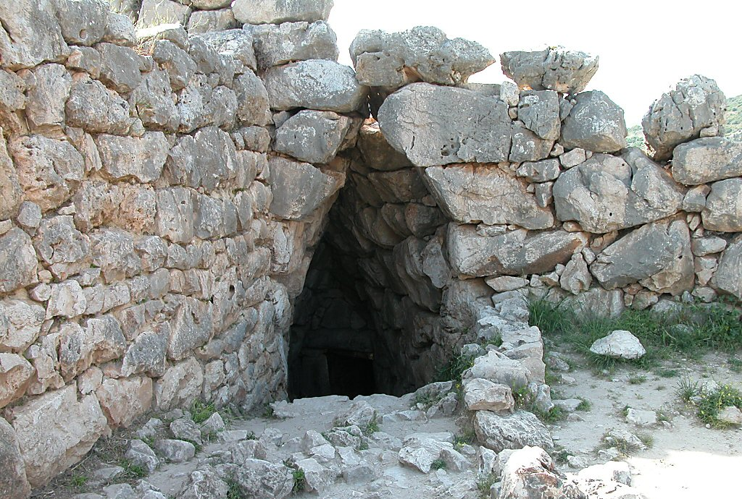
Mycenae secret cistern entrance
Notes:
The secret cistern at the northeastern end of the citadel at Mycenae is similar to those found at Athens and Tiryns. A passageway leads into the wall, down a flight of stairs, and into the cistern. This would have provided the citadel with water, even during a siege.
tb050903216

Slide 50
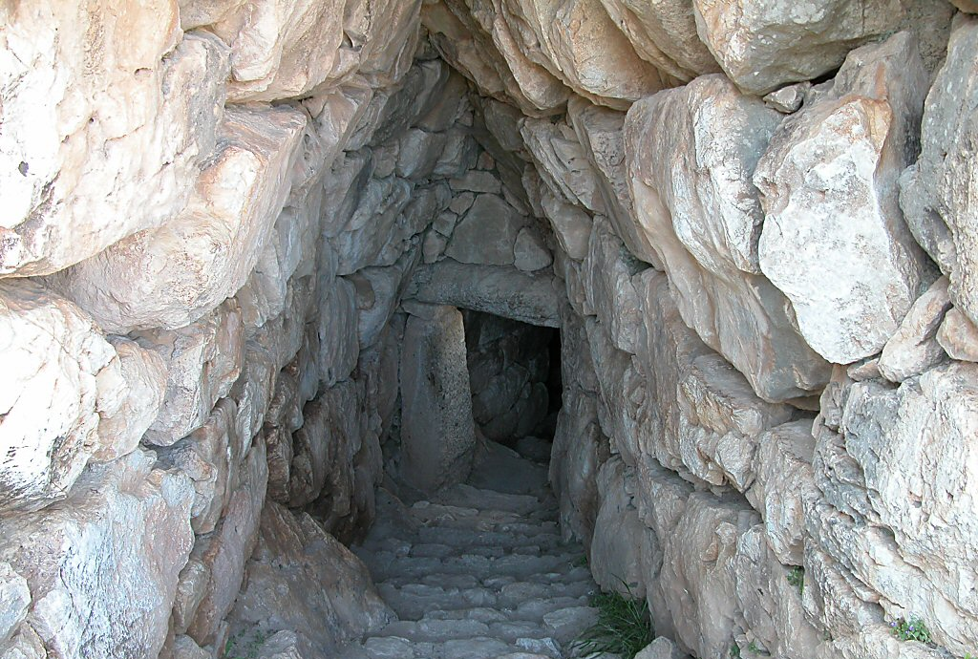
Mycenae secret cistern entrance
Notes:
tb050903217

Slide 51
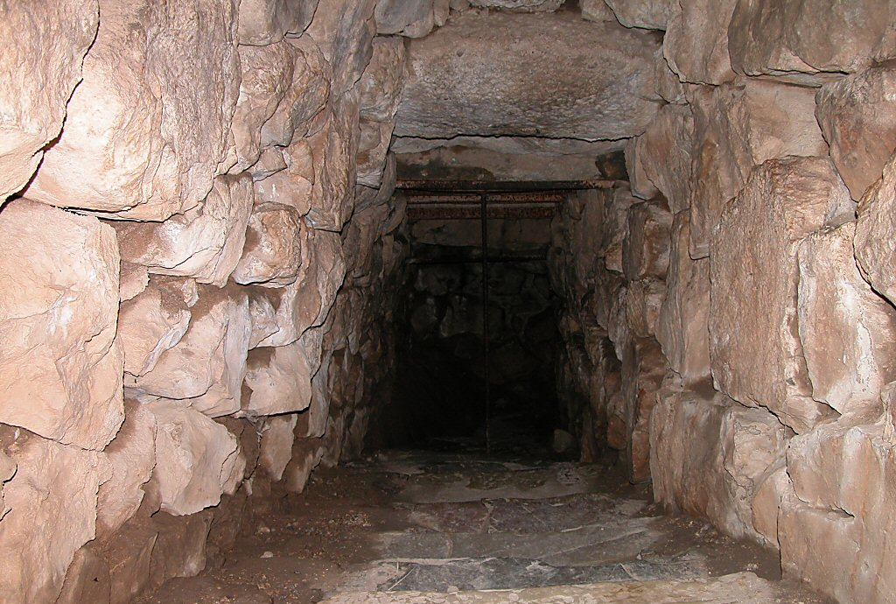
Mycenae secret cistern staircase
Notes:
tb050903220

Slide 52

Mycenae Lion Tomb entrance
Notes:
The Lion Tomb is a tholos (beehive-shaped) tomb, one of the nine located at Mycenae and one hundred found throughout Greece. Typical of the Late Helladic II to IIA periods in Mycenae (15th century BC and later), this type of tomb was luxurious. At one point these tombs were filled with riches and treasures, but like this one, most were plundered in ancient times. Because of their riches, many were labeled as treasuries in the time of Pausanias. It was not until skeletons were actually found in one at Athens that their true purpose was understood. The dromos (pictured above) was a passageway cut into the hill leading to the actual tomb, or tholos. The inner tholos had a circular floor which formed the base of a cone. The highest part of the dome typically had a height equal to the diameter of the base, although the Lion Tomb dome has collapsed over time.
tb050903227

Slide 53

Mycenae Lion Tomb from above
Notes:
tb050903229

Slide 54

Mycenae museum
Notes:
The on-site museum features various finds from the excavations at Mycenae, though the National Archaeological Museum of Athens houses many of the site’s most important artifacts.
tb011123710

Slide 55

Mycenae Treasury of Atreus from above
Notes:
bjb011123028

Slide 56

Mycenae Treasury of Atreus passage and entrance
Notes:
Located south of the citadel, the Treasury of Atreus features a chamber 43 feet (13 meters) high and 46 feet (14 meters) in diameter. It is presumed that this tomb structure, built in the 14th century, was the resting place of Atreus (king of Mycenae) and his family. Of Mycenae's tholos tombs, this is the most impressive.
tb011123649

Slide 57

Mycenae Treasury of Atreus passage and entrance
Notes:
tb011123621

Slide 58

Mycenae Treasury of Atreus passage and entrance
Notes:
tb011123640

Slide 59

Mycenae Treasury of Atreus passage and entrance
Notes:
The façade of the entryway was once decorated by green marble columns and (in the triangular space above the lintel) a carved slab of red marble. A double wooden door once sealed the entrance. All of these decorative elements would have been hidden after the funeral, when the entryway was filled in with dirt.
tb011123629

Slide 60

Mycenae Treasury of Atreus entrance
Notes:
The lintel stone is estimated to weigh about 120 tons.
tb011123638

Slide 61

Mycenae Treasury of Atreus entrance
Notes:
bjb011123016

Slide 62

Mycenae Treasury of Atreus entrance
Notes:
tb011123637

Slide 63

Mycenae Treasury of Atreus vaulted chamber with entrance
Notes:
The contents of the tomb were carried off sometime in antiquity, but the tomb structure itself has been standing firmly for the past 34 centuries or so.
tb011123634

Slide 64

Mycenae Treasury of Atreus vaulted chamber with entrance
Notes:
tb011123633

Slide 65

Mycenae Treasury of Atreus vaulted chamber
Notes:
Helpful Sources on Mycenae
Barber, R.
2001 Greece: Blue Guide. New York: WW Norton.
Fant, C., and M. Reddish.
2003 Biblical Sites in Greece and Turkey. New York: Oxford University Press.
Mee, C., and A. Spawforth.
2001 Greece: An Oxford Archaeological Guide. New York: Oxford University Press.
tb011123631

