Slide 1
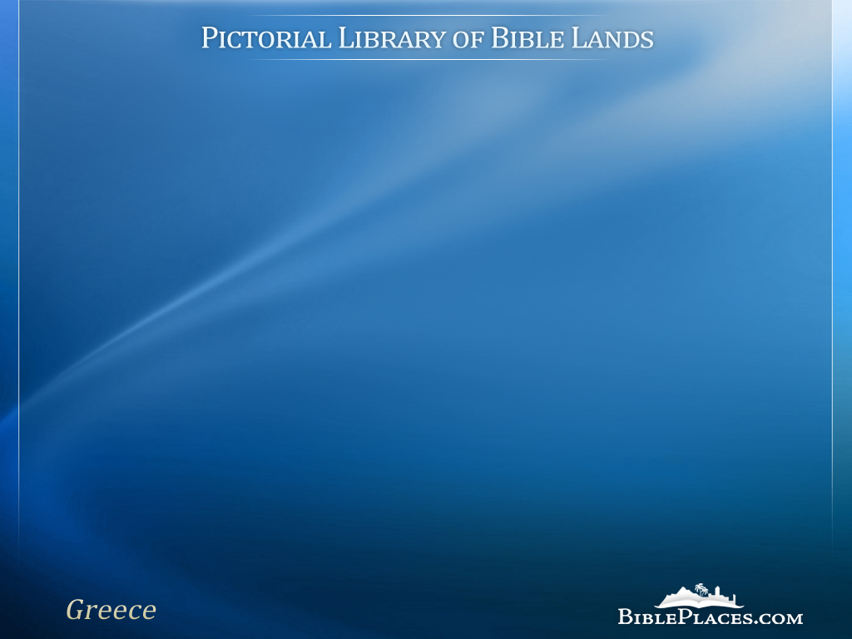
Cenchrea
“He had his hair cut off at Cenchrea because he had made a vow” (Acts 18:18)
Notes:
The Pictorial Library of Bible Lands provides PowerPoint files in addition to individual jpg images. The PowerPoint files are organized in logical sequence and may provide a quicker option for copying slides into other presentations. The PowerPoint files also include annotations about the sites and images that are not available elsewhere.
The images in the PowerPoints are approximately 1024x768 pixels, the maximum size displayed by many projectors. Users will particularly benefit from accessing the individual higher-resolution jpg images if (1) they have a projection system higher than 1024x768; (2) they want to zoom in on a particular portion of an image; or (3) they want to crop, edit, adapt, or print an image.

Slide 2
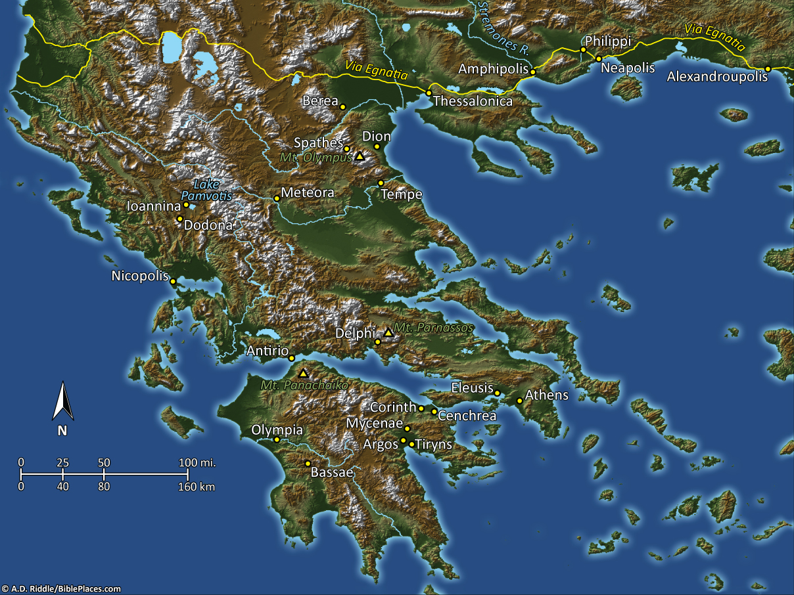
Pictorial Library Vol. 11: Greece
Notes:
This map is intended to help users locate the places which appear in the photographs in this presentation. The map therefore does not represent or label every geographic feature, and the sites are a mixture of modern and ancient place names.

Slide 3
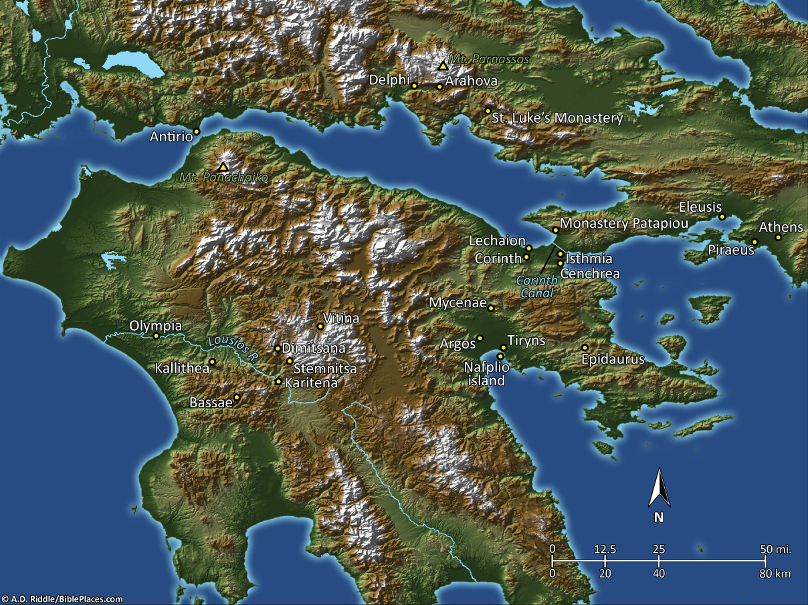
Pictorial Library Vol. 11: Peloponnese
Notes:
This map is intended to help users locate the places which appear in the photographs in this presentation. The map therefore does not represent or label every geographic feature, and the sites are a mixture of modern and ancient place names.

Slide 4
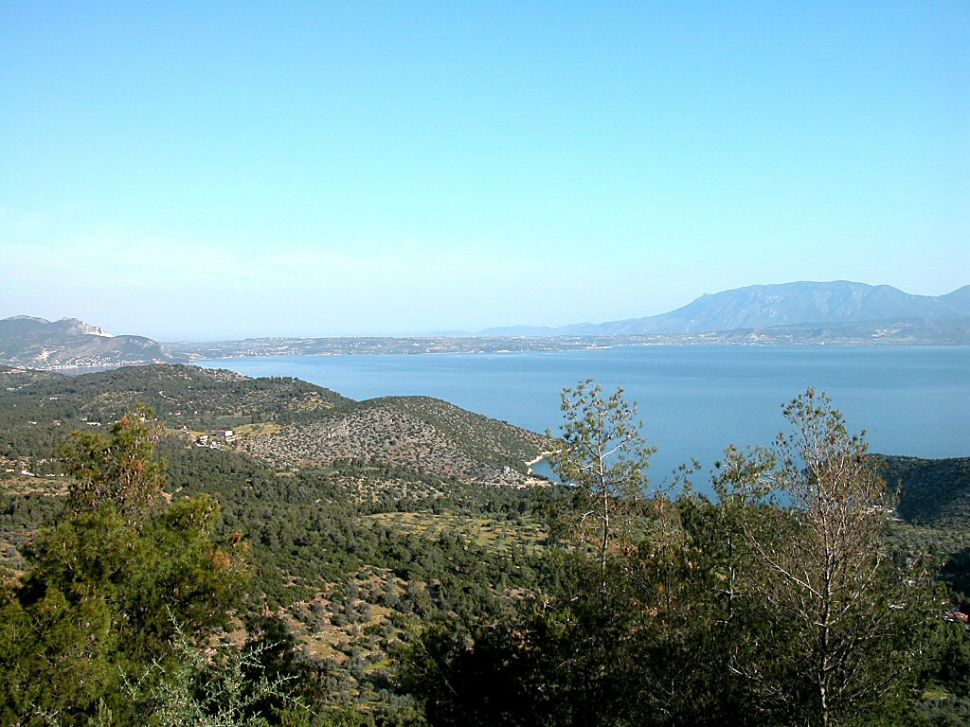
Cenchrea harbor from southeast
Notes:
Historical Background
Cenchrea (modern-day Keries) was located seven miles (11 km) southeast of Corinth and served as the city’s eastern port into the Aegean and Levant (Asia), while Corinth’s port into Italy and the west was Lechaion. Because of its relation to Corinth, Cenchrea’s prosperity followed Corinth’s, enjoying both greatness and poverty parallel to Corinth. It sat on the Saronic Gulf just south of Isthmia, and was named for Cenchreas, son of Poseidon and Peirene (according to Pausanias).
The city was founded some time prior to the Peloponnesian War and was likely continually occupied until 146 BC, when Mummius crushed Corinth. When Julius Caesar revived Corinth in 44 BC, he remodeled Cenchrea’s harbor facilities and added two artificial rubble breakwaters.
Cenchrea reached its height in the 2nd century AD but continued to be an important port until the 6th century, despite earthquake and tidal wave damage in the 4th century. In AD 580, the Slavs and Avars destroyed Cenchrea. The city continued to be occupied into the Middle Ages but declined in importance.
tb050803912

Slide 5
Cenchrea harbor from southeast
Notes:
tb050803912

Slide 6
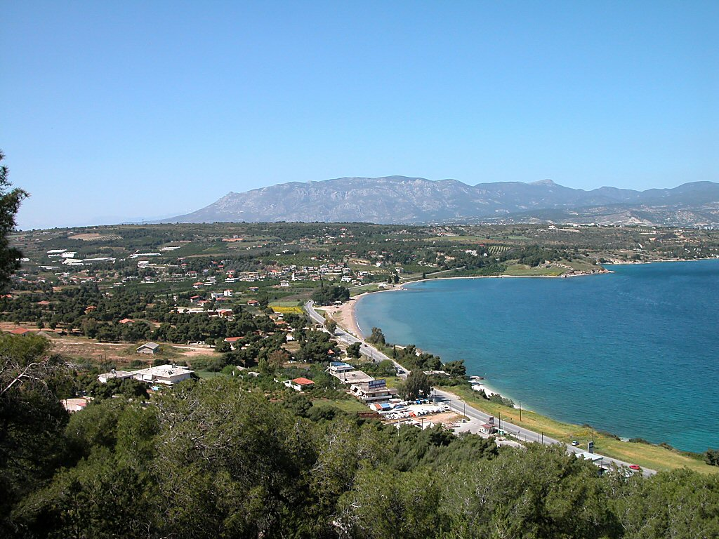
Cenchrea harbor from south
Notes:
tb050803953

Slide 7
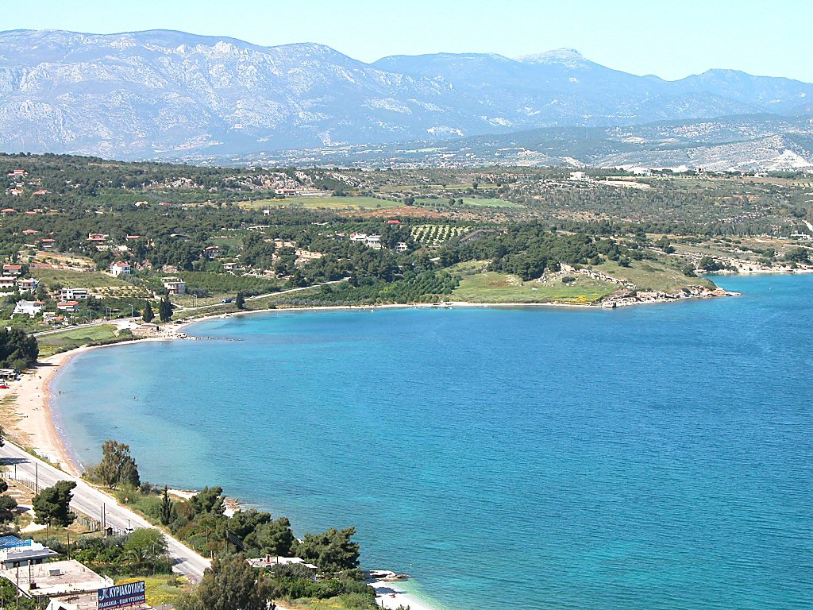
Cenchrea harbor from south
Notes:
tb050803952

Slide 8
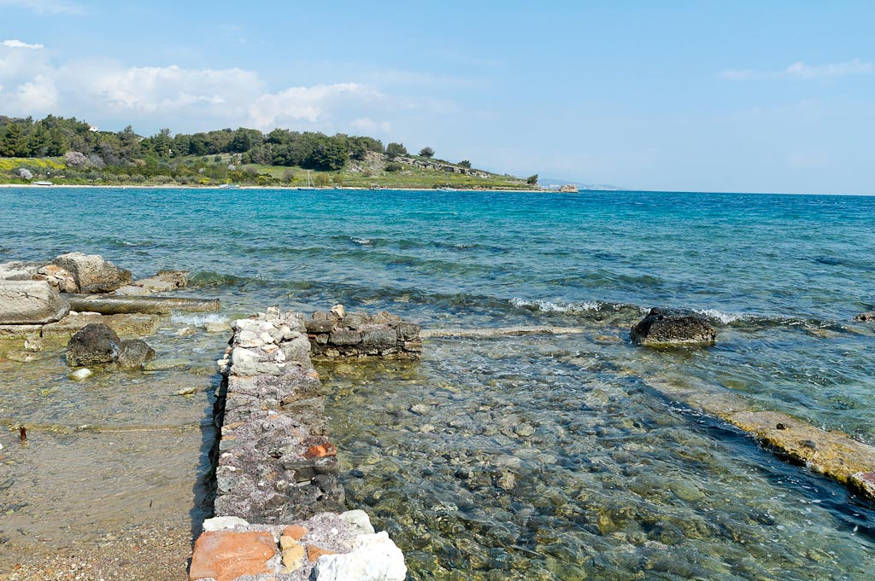
Cenchrea harbor from southern pier
Notes:
Excavations
Excavations at Cenchrea took place in the 1960s under R. L. Scranton and E. S. Ramage. J. W. Shaw conducted underwater excavations in 1967 with the University of Chicago and Indiana University.
Cenchrea’s Roman harbor was characterized by two piers—the south pier and the north pier. On the south pier sat several warehouses (first through fifth centuries), the sanctuary of Isis, fish-tanks, and now-submerged breakwaters. The north pier is now almost completely submerged, and only a tower remains. A brick-built complex dating to AD 100 rests on land just north of the submerged moles, along with a limestone tomb.
tb031706946

Slide 9
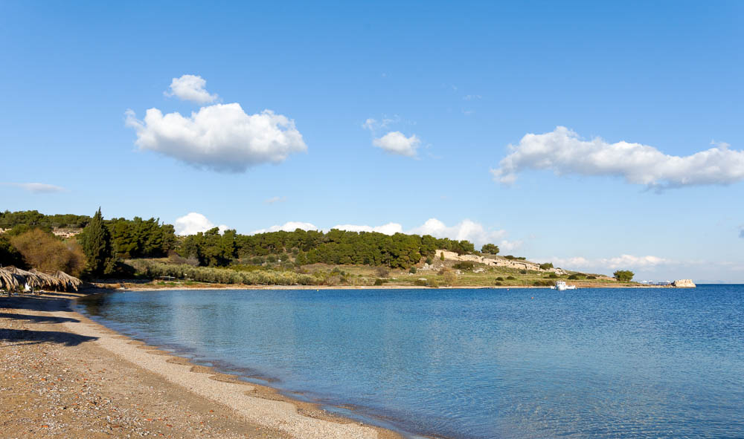
Cenchrea harbor from south
Notes:
tb011017149

Slide 10
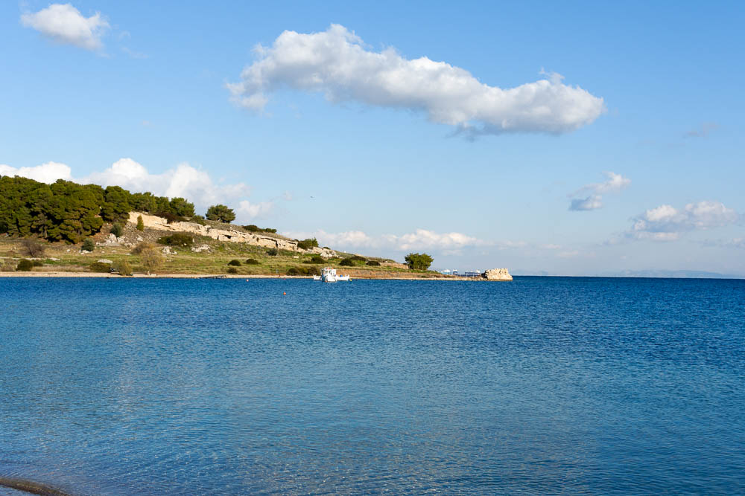
Cenchrea harbor from south
Notes:
Biblical Significance
Acts 18:18 (KJV) “. . . having shorn his head in Cenchrea: for he had a vow.” Paul came through Cenchrea on his second missionary journey at the end of an 18-month stay at Corinth. He made his way from Corinth to Antioch after standing before Gallio, proconsul of Achaia (ca. AD 51). When he left Cenchrea, he stopped next in Ephesus for a short time and then continued on to Caesarea (Acts 18:19-22).
Romans 16:1 (KJV) “I commend unto you Phebe our sister, which is a servant of the church which is at Cenchrea.” Phoebe, the woman who delivered Paul’s epistle to the Romans, was a deaconess at the church of Cenchrea.
tb011017150

Slide 11
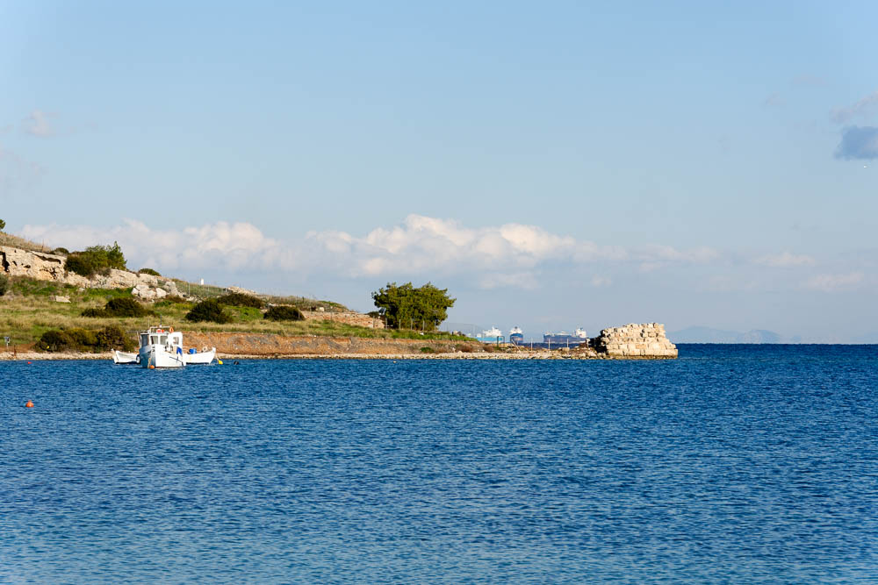
Cenchrea harbor north pier from south
Notes:
tb011017152

Slide 12
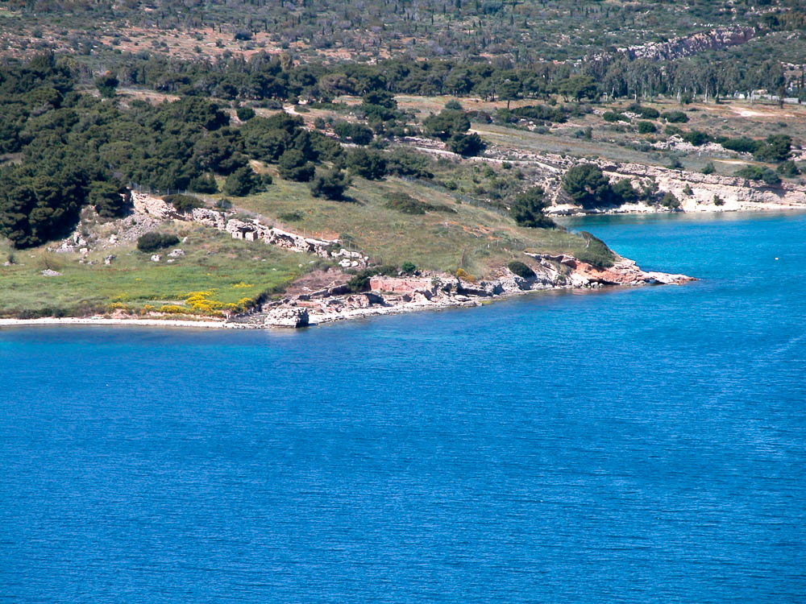
Cenchrea harbor north pier from south
Notes:
In the 2nd century AD, the Greek historian Pausanias reported that there was a bronze statue of Poseidon at the northern side of the harbor.
tb050803954

Slide 13
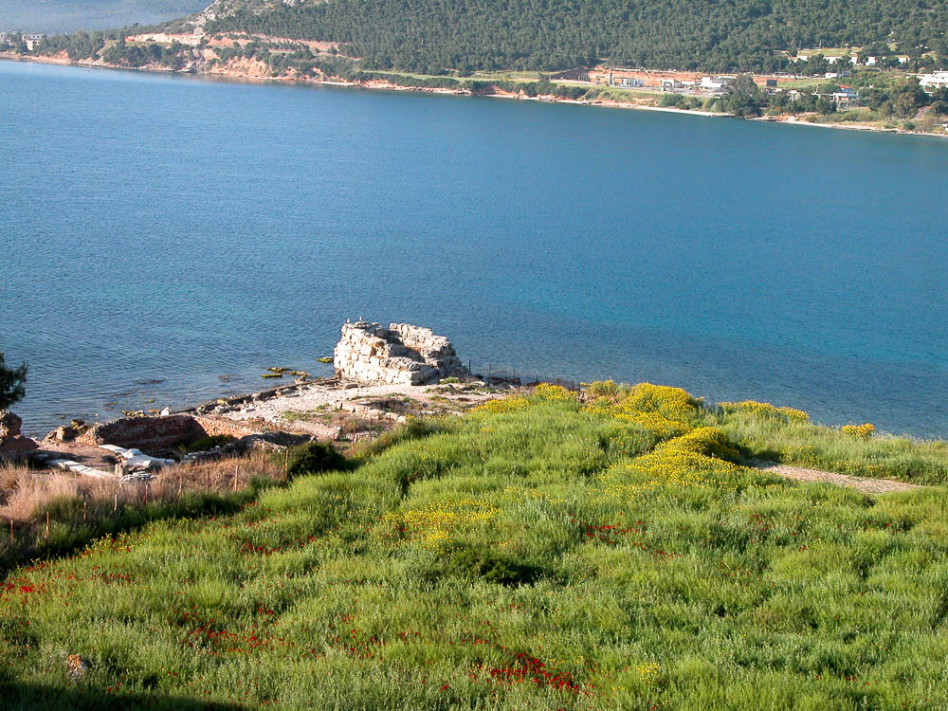
Cenchrea harbor north pier from north
Notes:
tb050803904

Slide 14
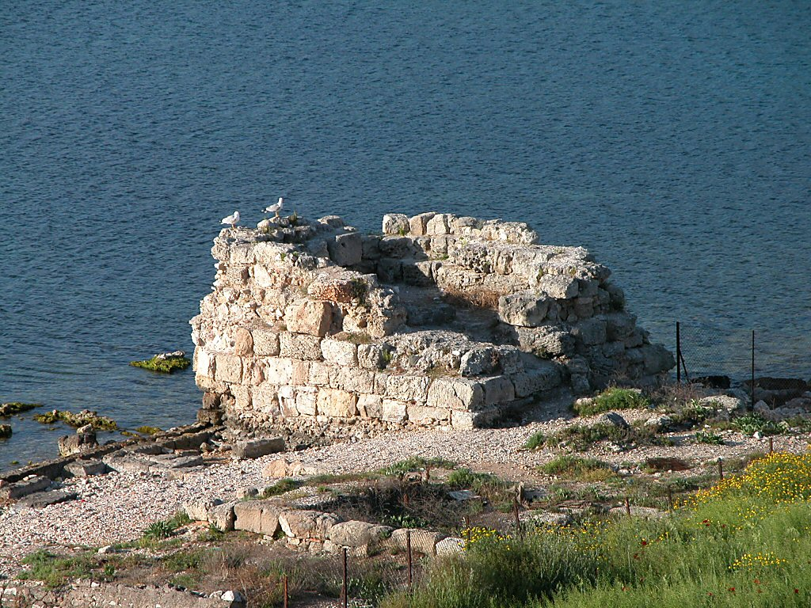
Cenchrea harbor north pier from north
Notes:
This is the remaining tower (a lookout or lighthouse) on the north pier, dating to the 6th century AD or later.
tb050803909

Slide 15
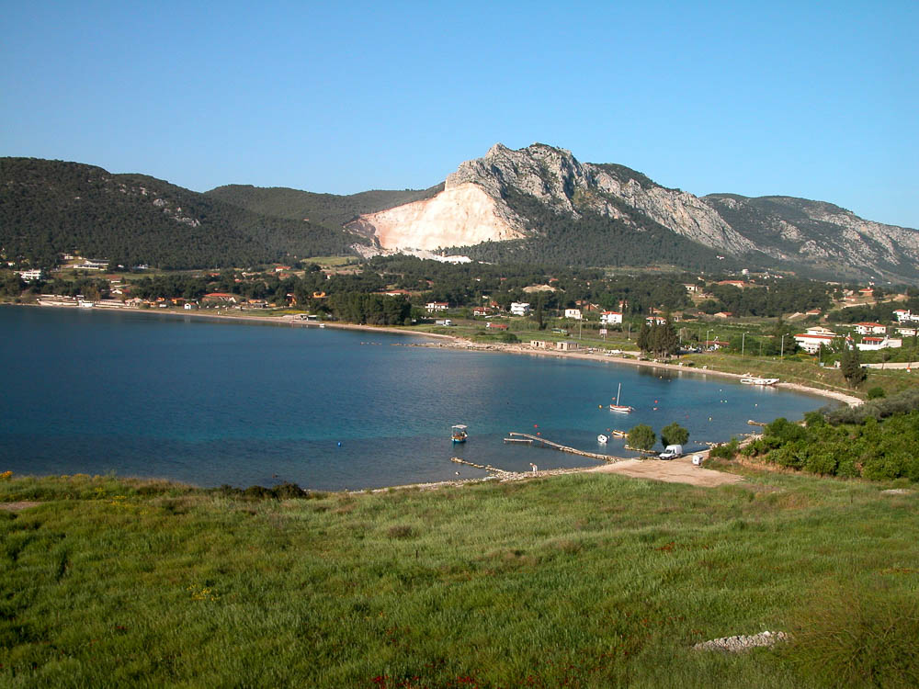
Cenchrea harbor from north
Notes:
tb050803903

Slide 16
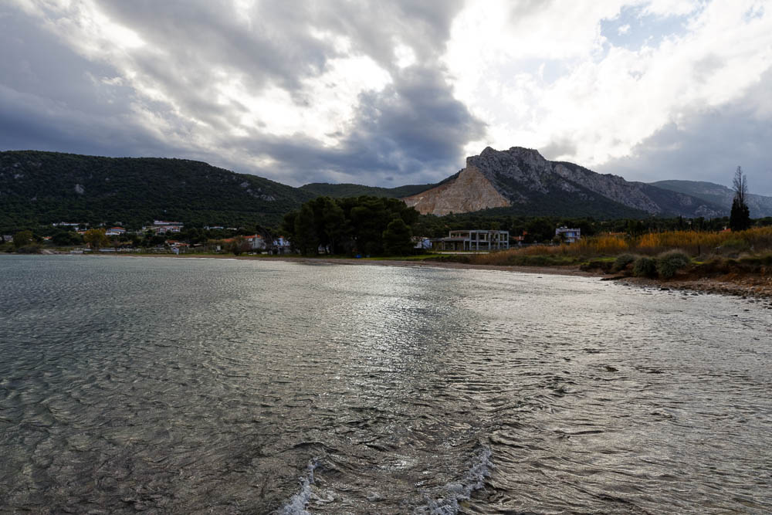
Cenchrea bay from north
Notes:
According to Pausanias, Cenchrea hosted several shrines. In addition to the shrine of Isis, which has been identified by the excavators, there were also sanctuaries of Asclepius and Aphrodite.
jc0111152541

Slide 17
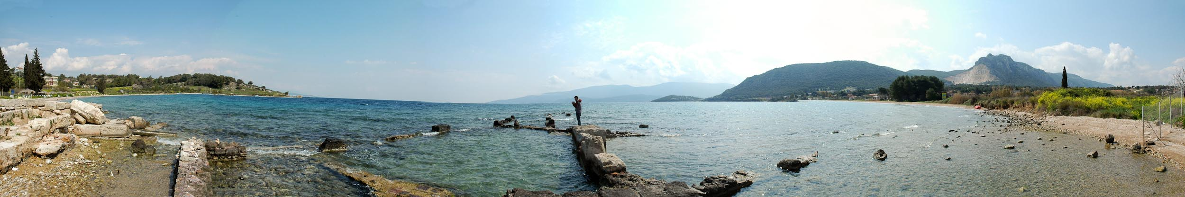
Cenchrea harbor panorama
Notes:
tb03170694p

Slide 18
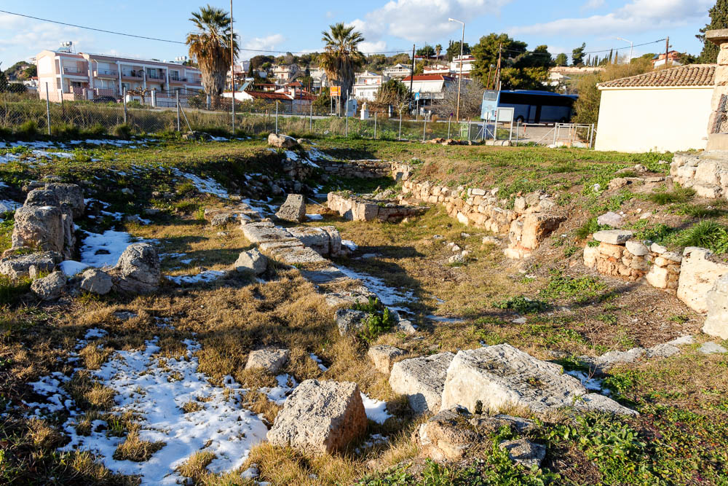
Cenchrea harbor excavations near Byzantine church
Notes:
tb011017167

Slide 19
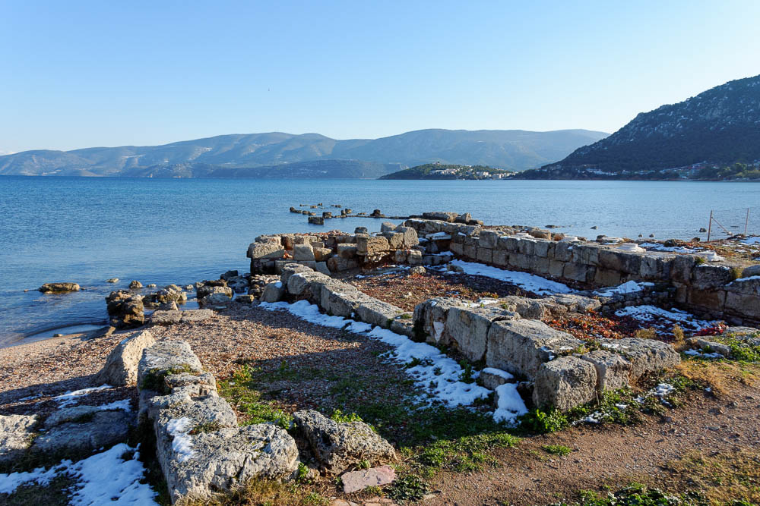
Cenchrea harbor Byzantine church
Notes:
Most of the visible remains at Cenchrea are gathered at the southern pier, including the sanctuary of Isis. Several notable items were sealed at the site during an earthquake in around AD 375. These include colored glass opus sectile panels (AD 361-363), wooden furniture, a pulley gate, bone and ivory decoration, and full portraits of Homer, Plato, and others.
tb011017155

Slide 20
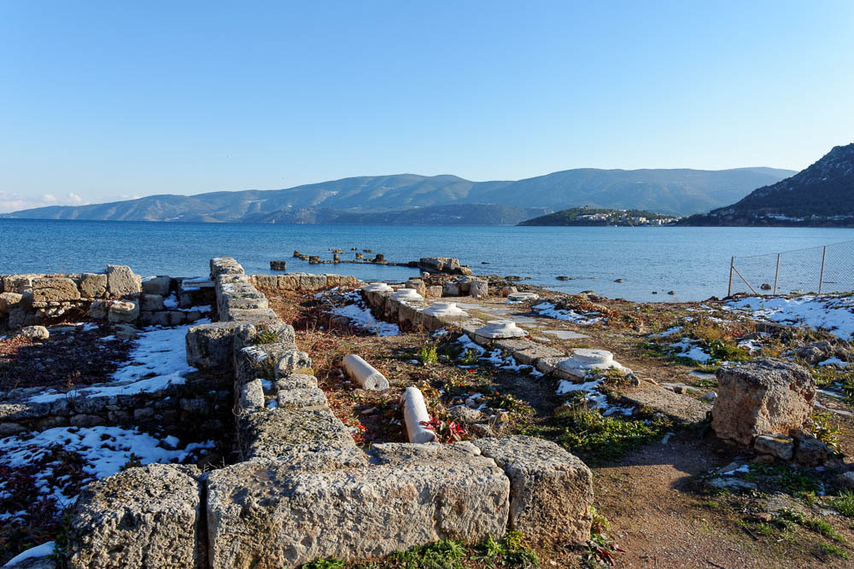
Cenchrea harbor Byzantine church
Notes:
In the 4th century AD, Cenchrea housed a large Christian center at the southern end of the harbor. It eventually took over earlier structures, including the Isis sanctuary, which was repurposed as a church. It served in that capacity until at least 580.
tb011017158

Slide 21
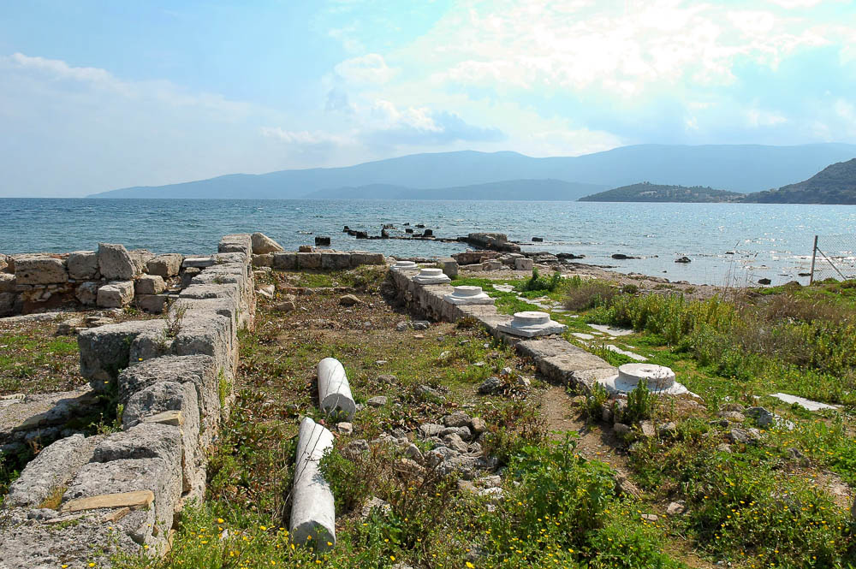
Cenchrea harbor Byzantine church
Notes:
tb031706941

Slide 22
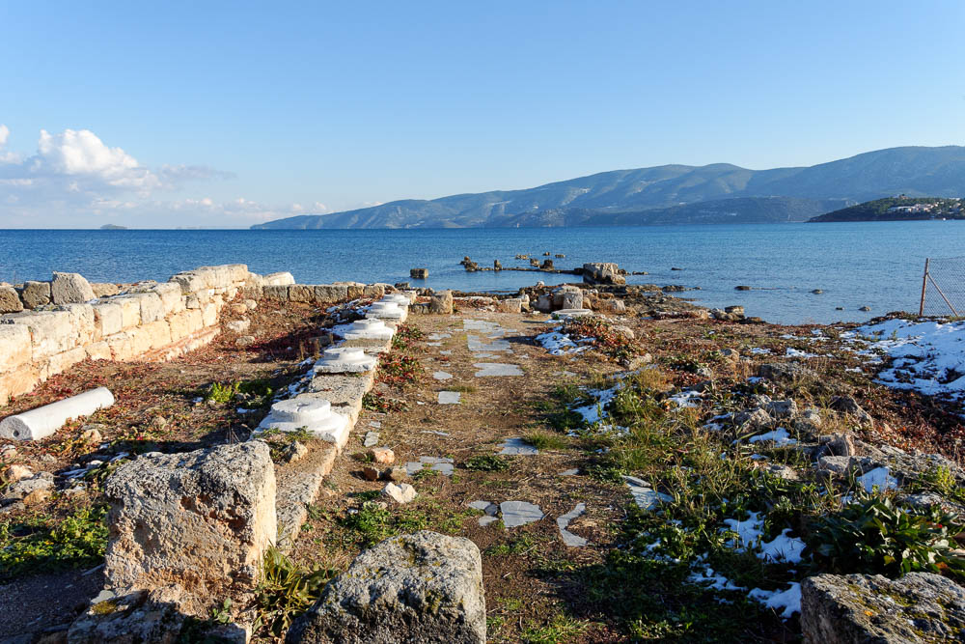
Cenchrea harbor Byzantine church
Notes:
This hall is only part of the original sanctuary. What seems like a slightly older (circa AD 100) section is now submerged.
tb011017160

Slide 23
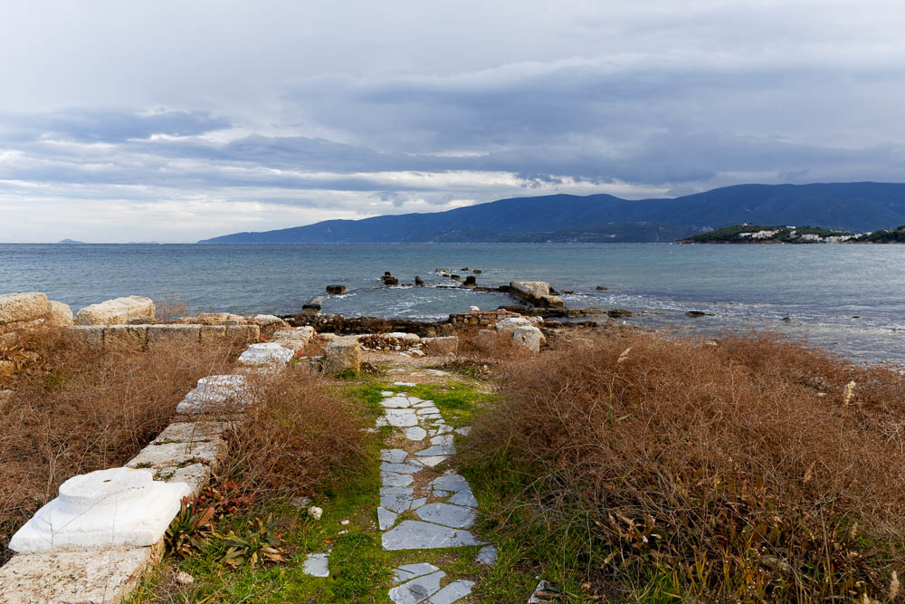
Cenchrea harbor with Byzantine church
Notes:
jc0111152542

Slide 24
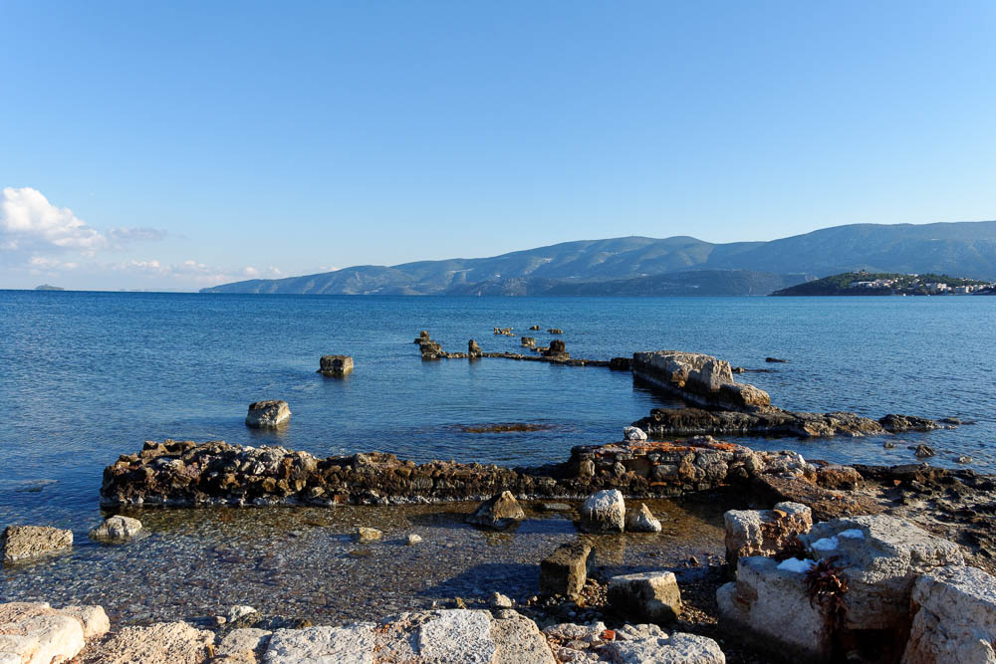
Cenchrea harbor with Sanctuary of Isis
Notes:
Because the worship of Isis was spread largely through traveling merchants, she had a prominent presence in Greek port cities.
tb011017163

Slide 25
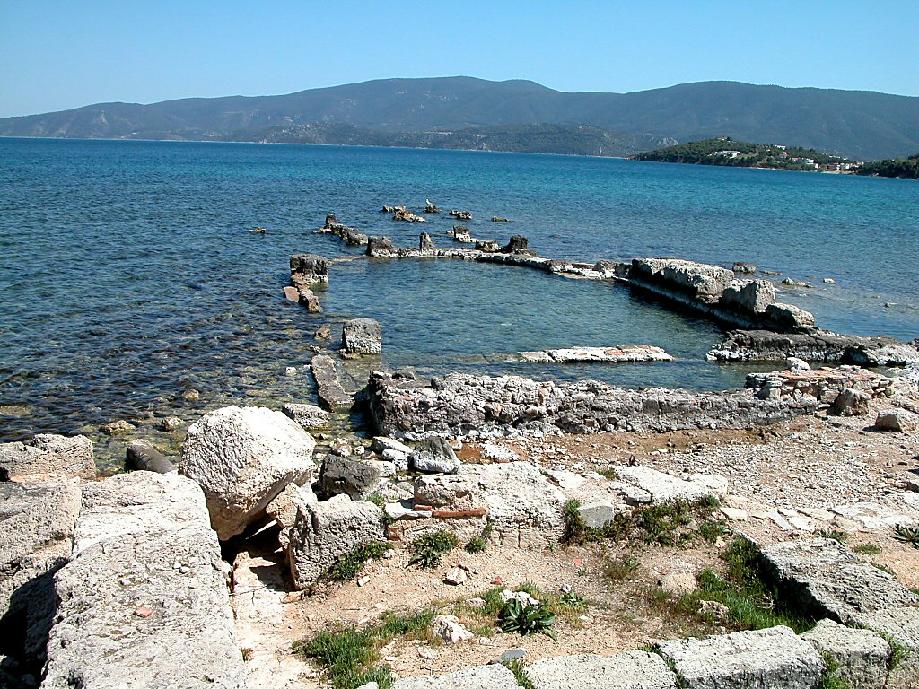
Cenchrea harbor Sanctuary of Isis
Notes:
tb050803956

Slide 26
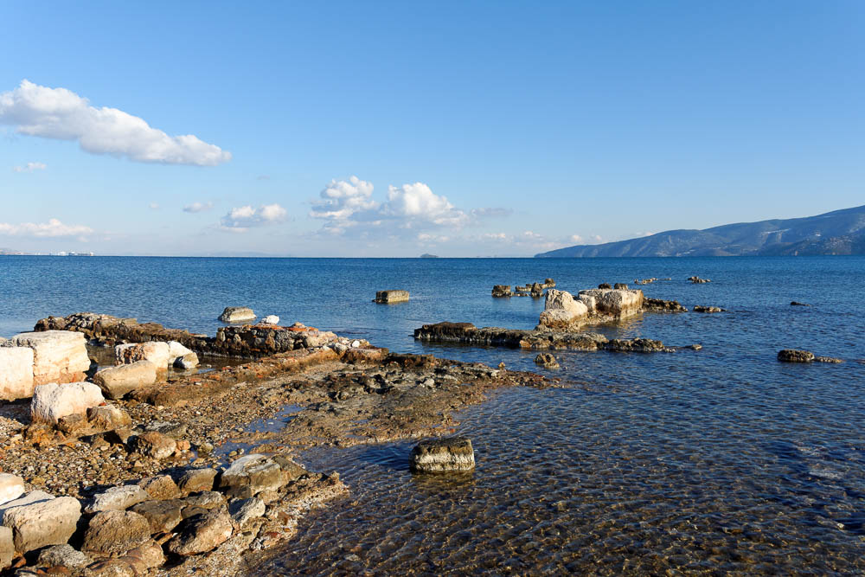
Cenchrea harbor with Sanctuary of Isis
Notes:
When the wider Mediterranean world began worshipping Isis, she came to be viewed by some as the protector of sailing ships. This would explain why she had a sanctuary right on the harbor.
tb011017164

Slide 27
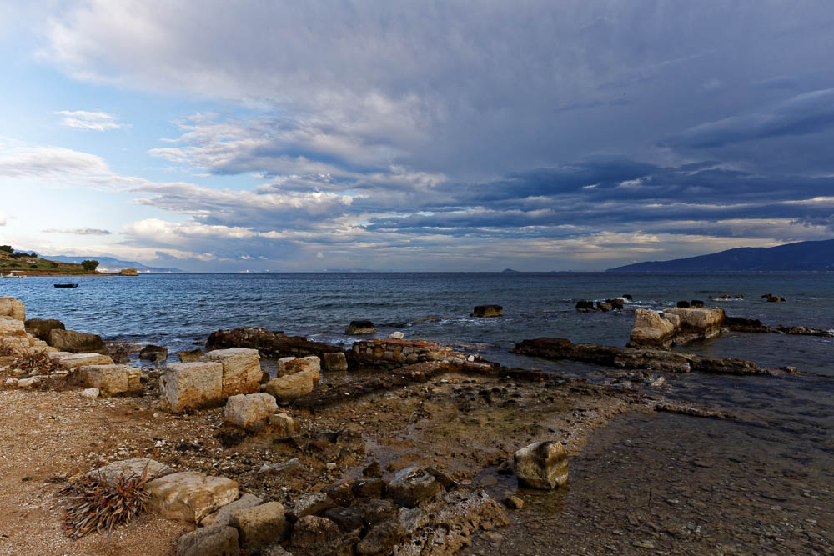
Cenchrea harbor Sanctuary of Isis
Notes:
jc0111152547

Slide 28
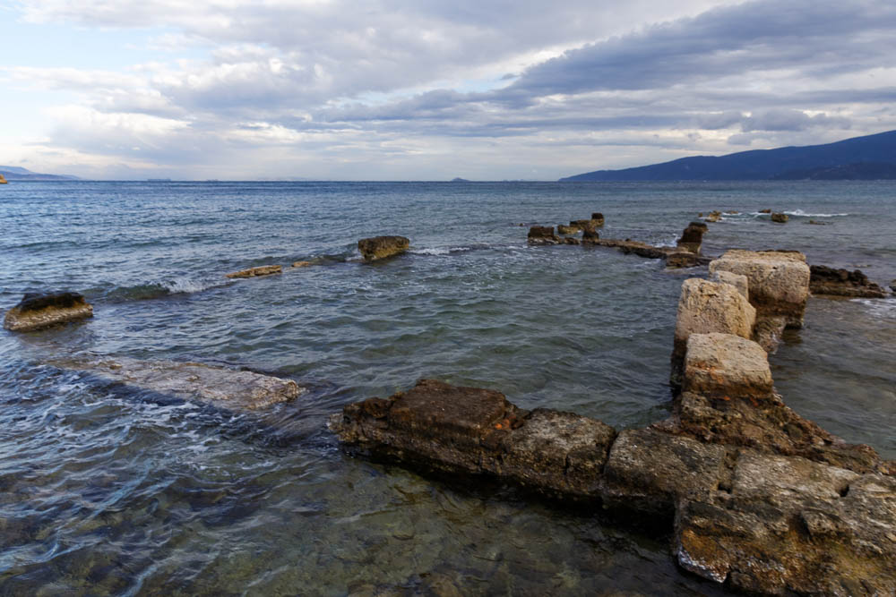
Cenchrea harbor Sanctuary of Isis
Notes:
jc0111152533

Slide 29
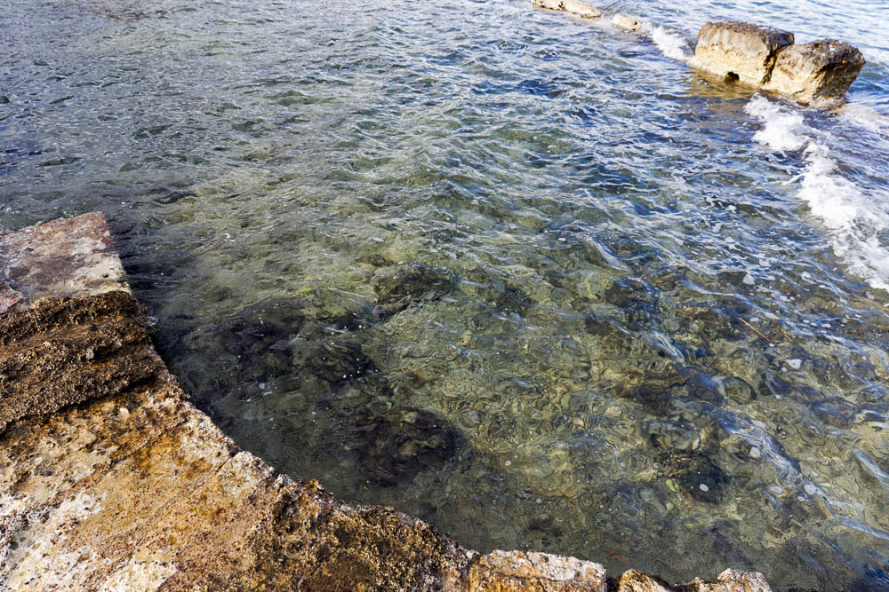
Cenchrea harbor Sanctuary of Isis
Notes:
jc0111152539

Slide 30
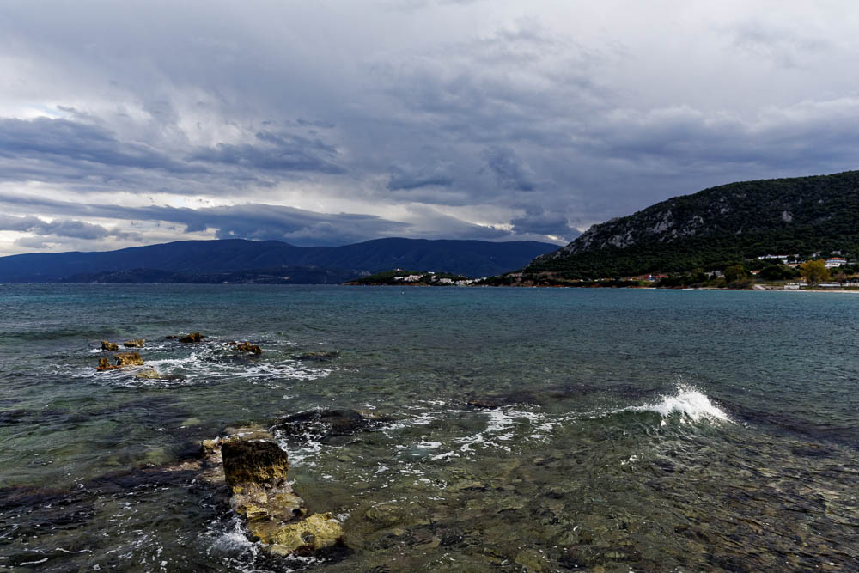
Cenchrea harbor Sanctuary of Isis
Notes:
jc0111152537

Slide 31
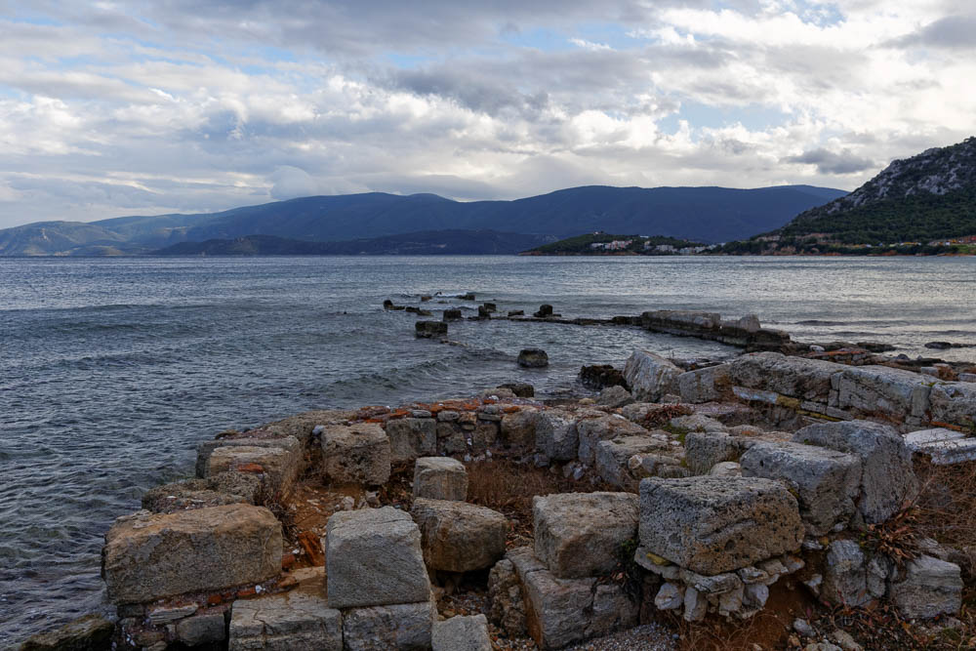
Cenchrea harbor Sanctuary of Isis with Byzantine Church
Notes:
Next to the sanctuary are the foundations of a warehouse, where goods must have been temporarily stored on their journey between Asia Minor and Corinth.
jc0111152531

Slide 32
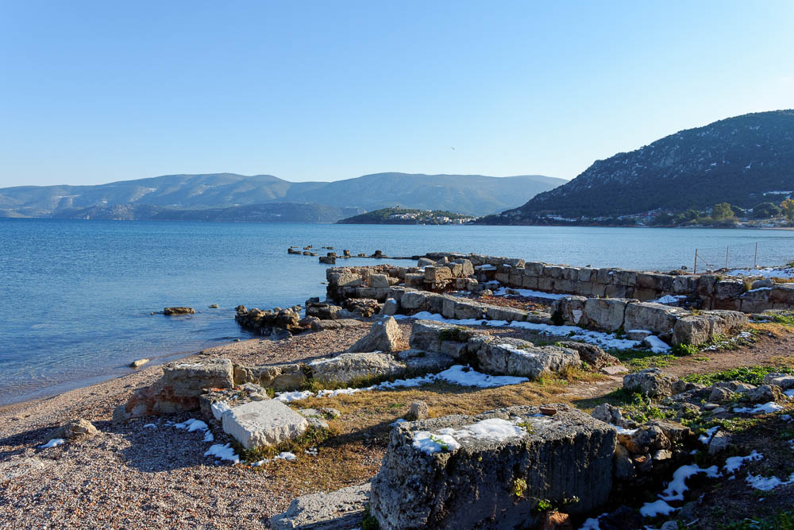
Cenchrea harbor with Byzantine church
Notes:
tb011017154

Slide 33
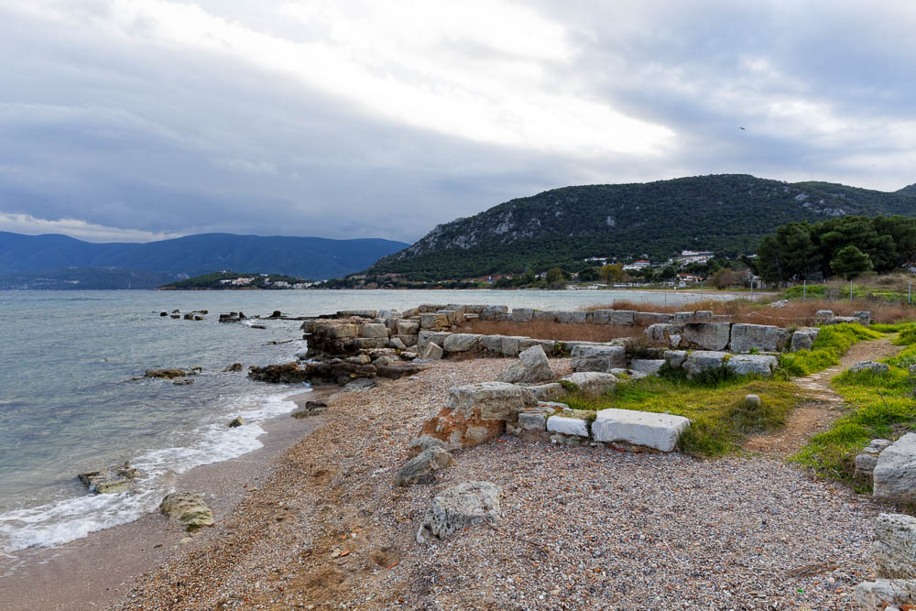
Cenchrea harbor Sanctuary of Isis with Byzantine Church
Notes:
The bay of Cenchrea enjoyed revived shipping activity in the early modern period, when locals began using it to transport produce.
jc0111152548

Slide 34
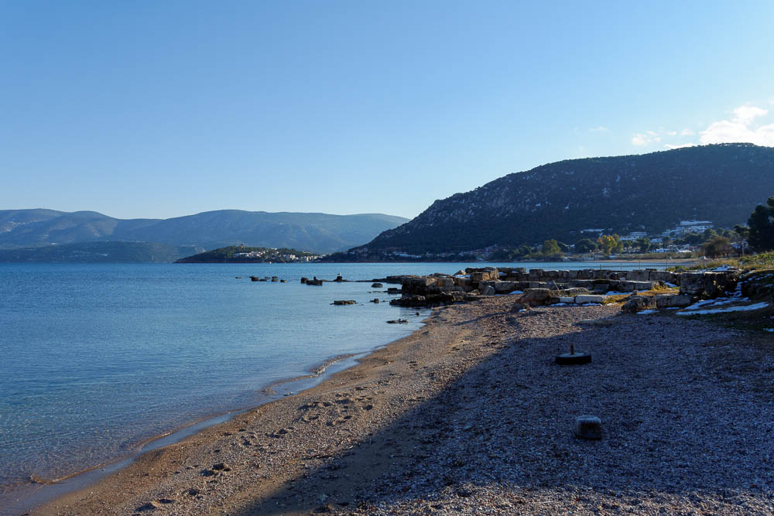
Cenchrea harbor with Byzantine church
Notes:
tb011017153

Slide 35
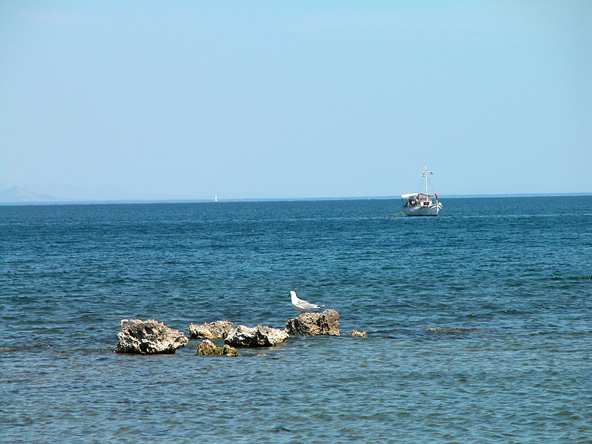
Cenchrea harbor southern mole with fishing boat
Notes:
The presence of modern fishers at Cenchrea continues another longstanding function of the bay. In fact, the Roman harbor had fish tank instillations, allowing commercial fishermen to keep their catches alive before selling them.
tb050803957

Slide 36
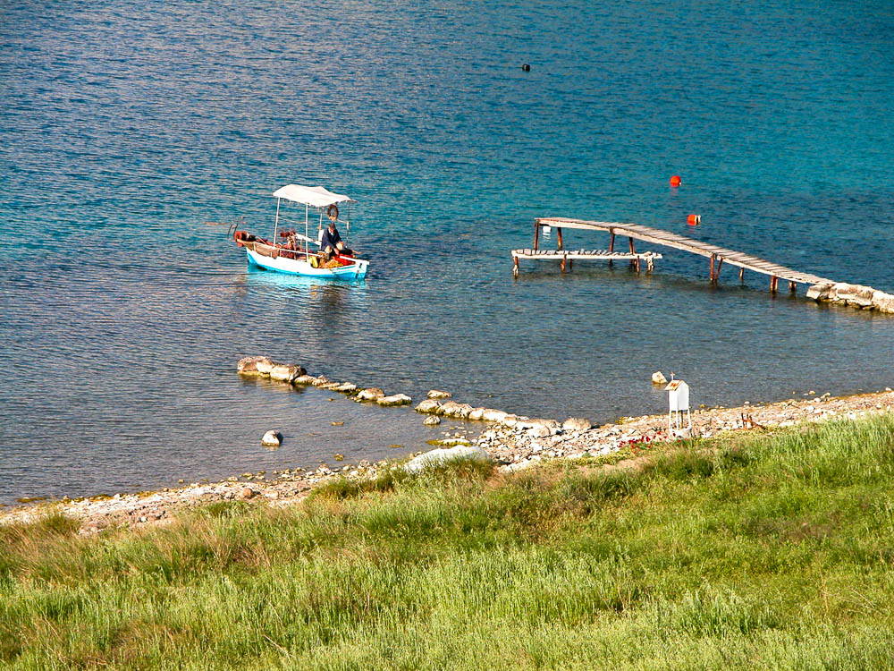
Cenchrea fishing boat
Notes:
Helpful Sources
Barber, R.
2001 Greece: Blue Guide. New York: WW Norton.
Fant, C., and M. Reddish.
2003 Biblical Sites in Greece and Turkey. New York: Oxford University Press.
McRay, John.
1991 Archaeology and the New Testament. Grand Rapids: Baker.
Mee, C., and A. Spawforth.
2001 Greece: An Oxford Archaeological Guide. New York: Oxford University Press.
tb050803911

